Slide 1
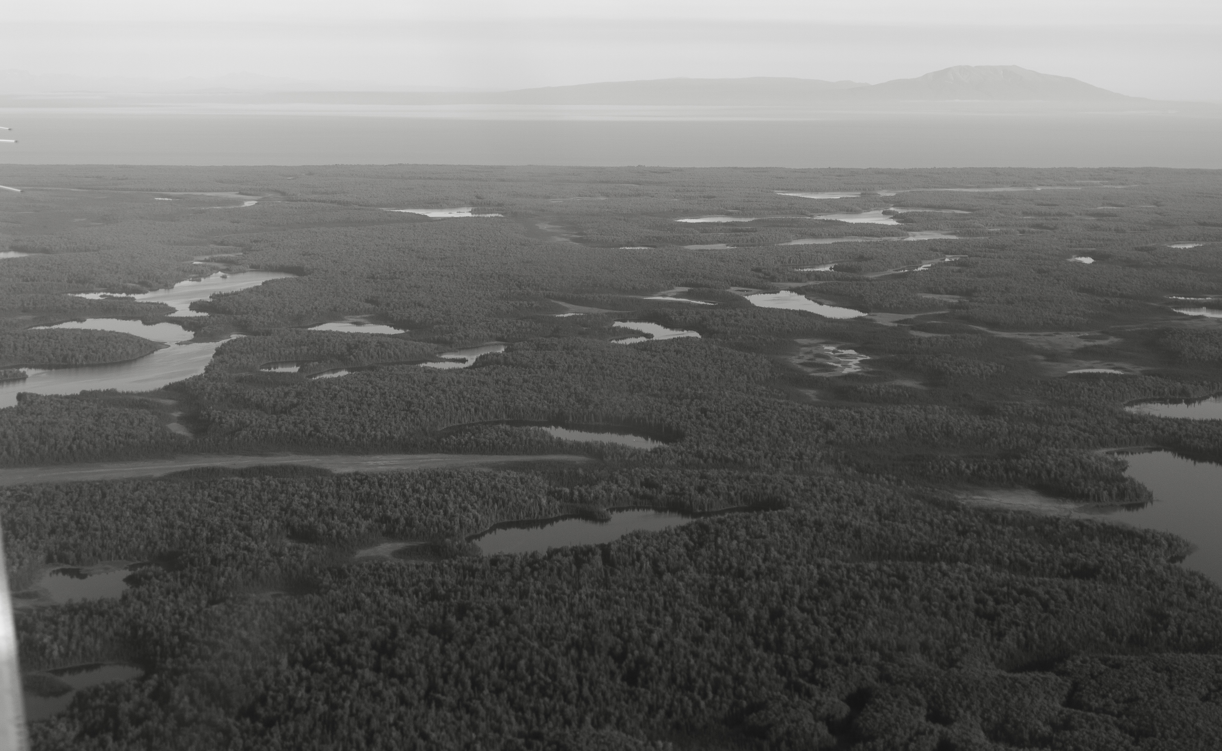
Spatiotemporal trends in salmon metapopulation contributions to portfolio effects in Western Alaska
Ben Makhlouf

Slide 2
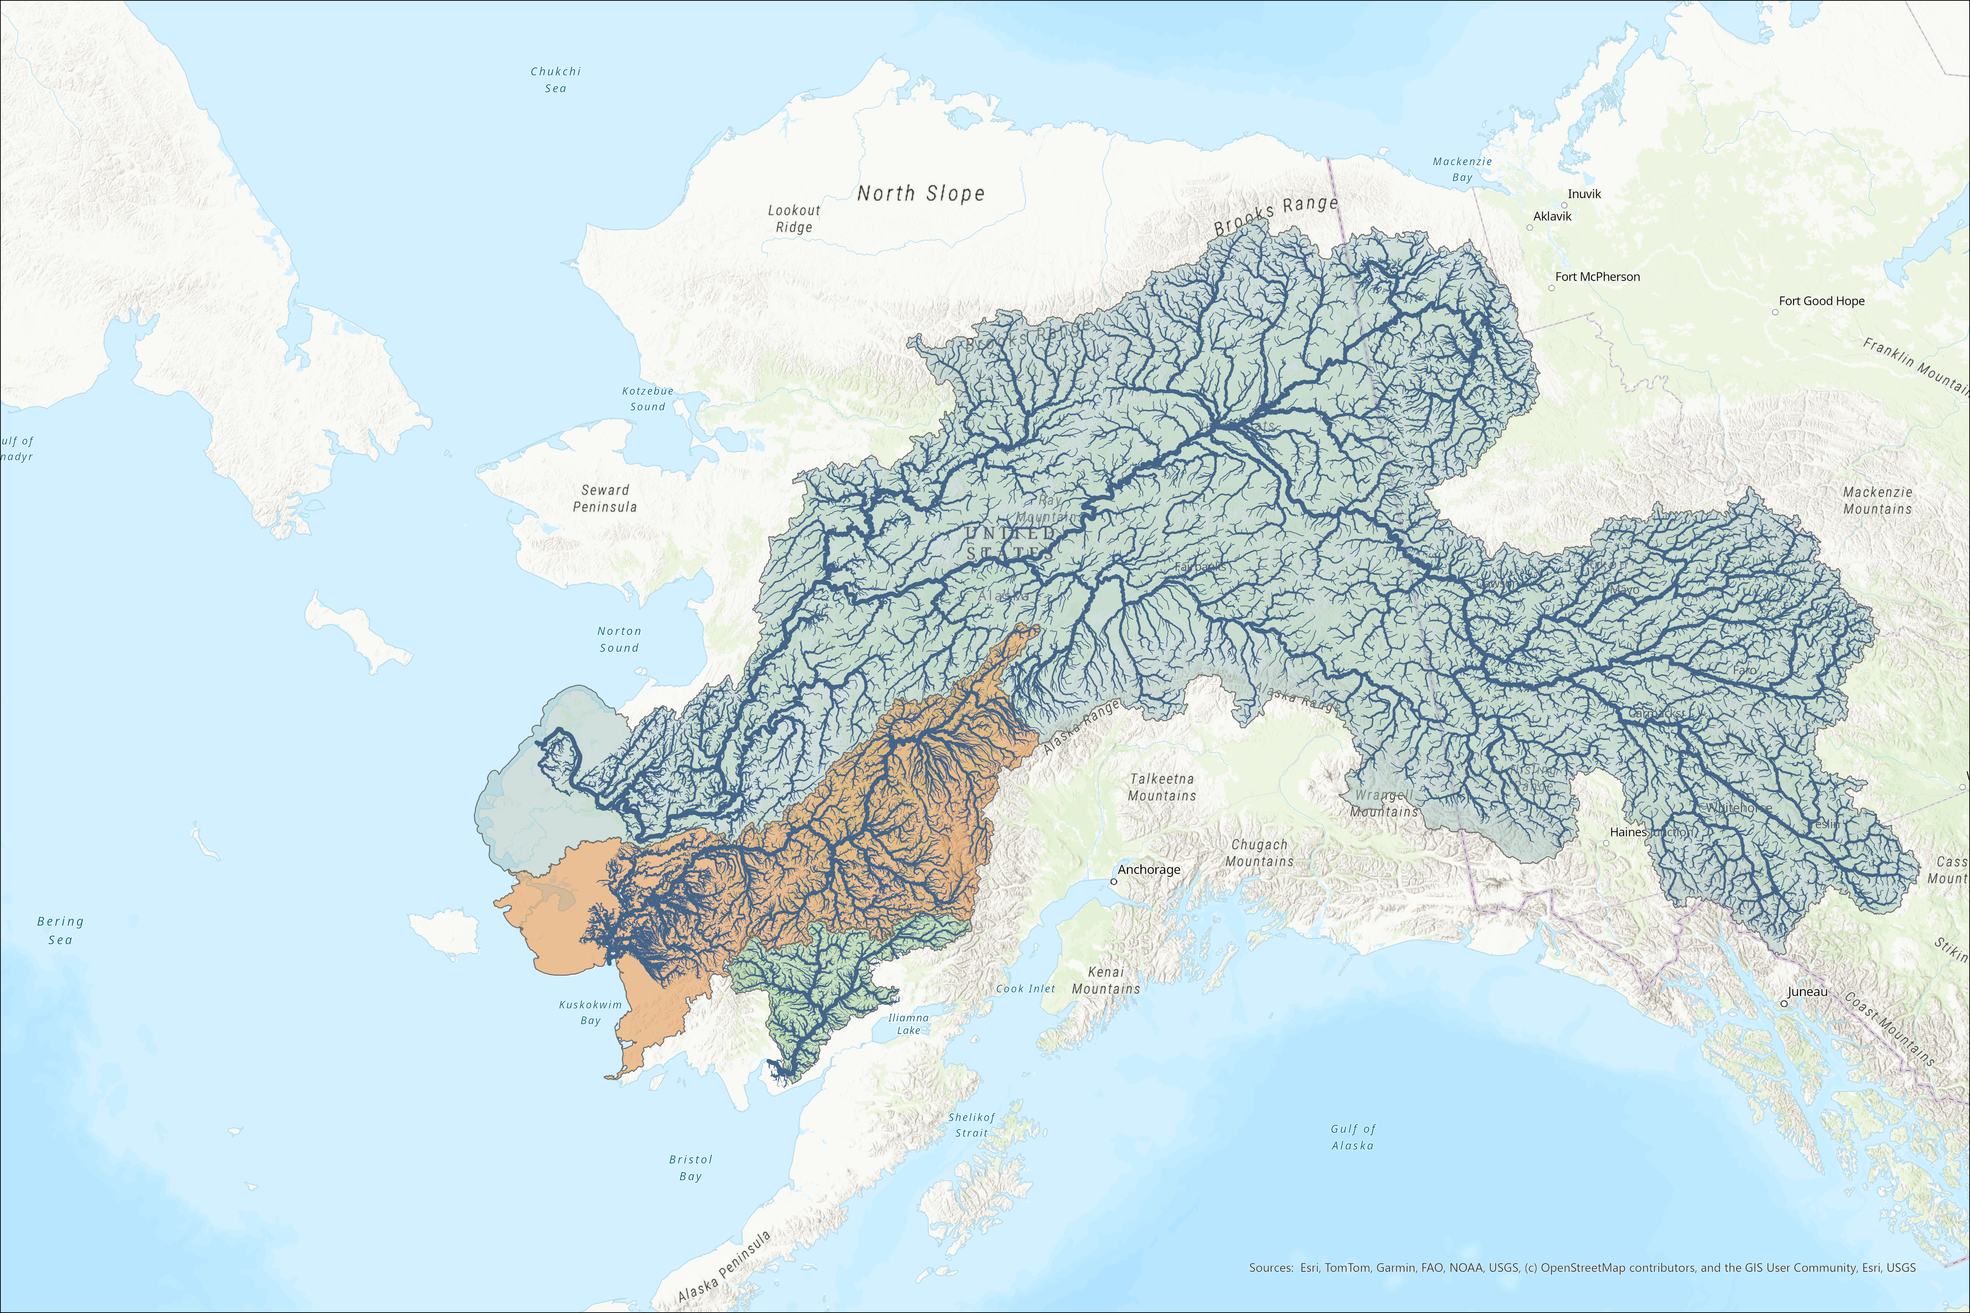


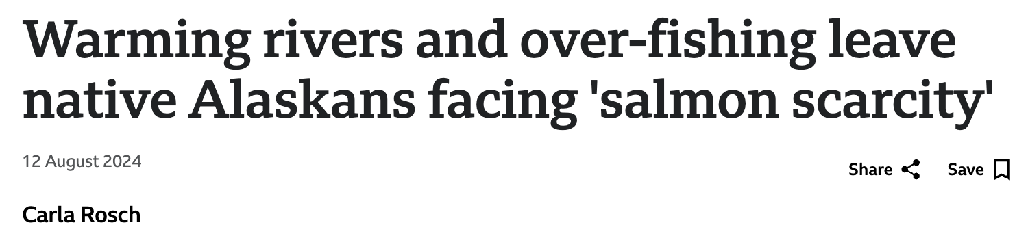

Slide 3
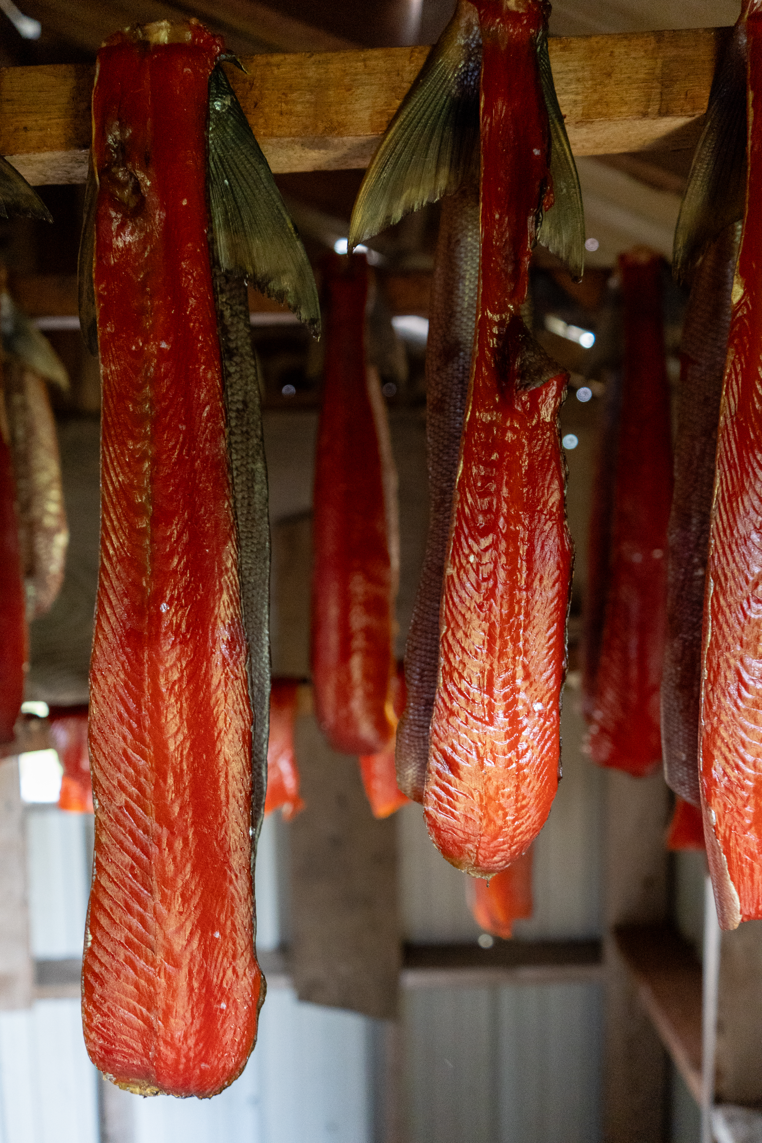
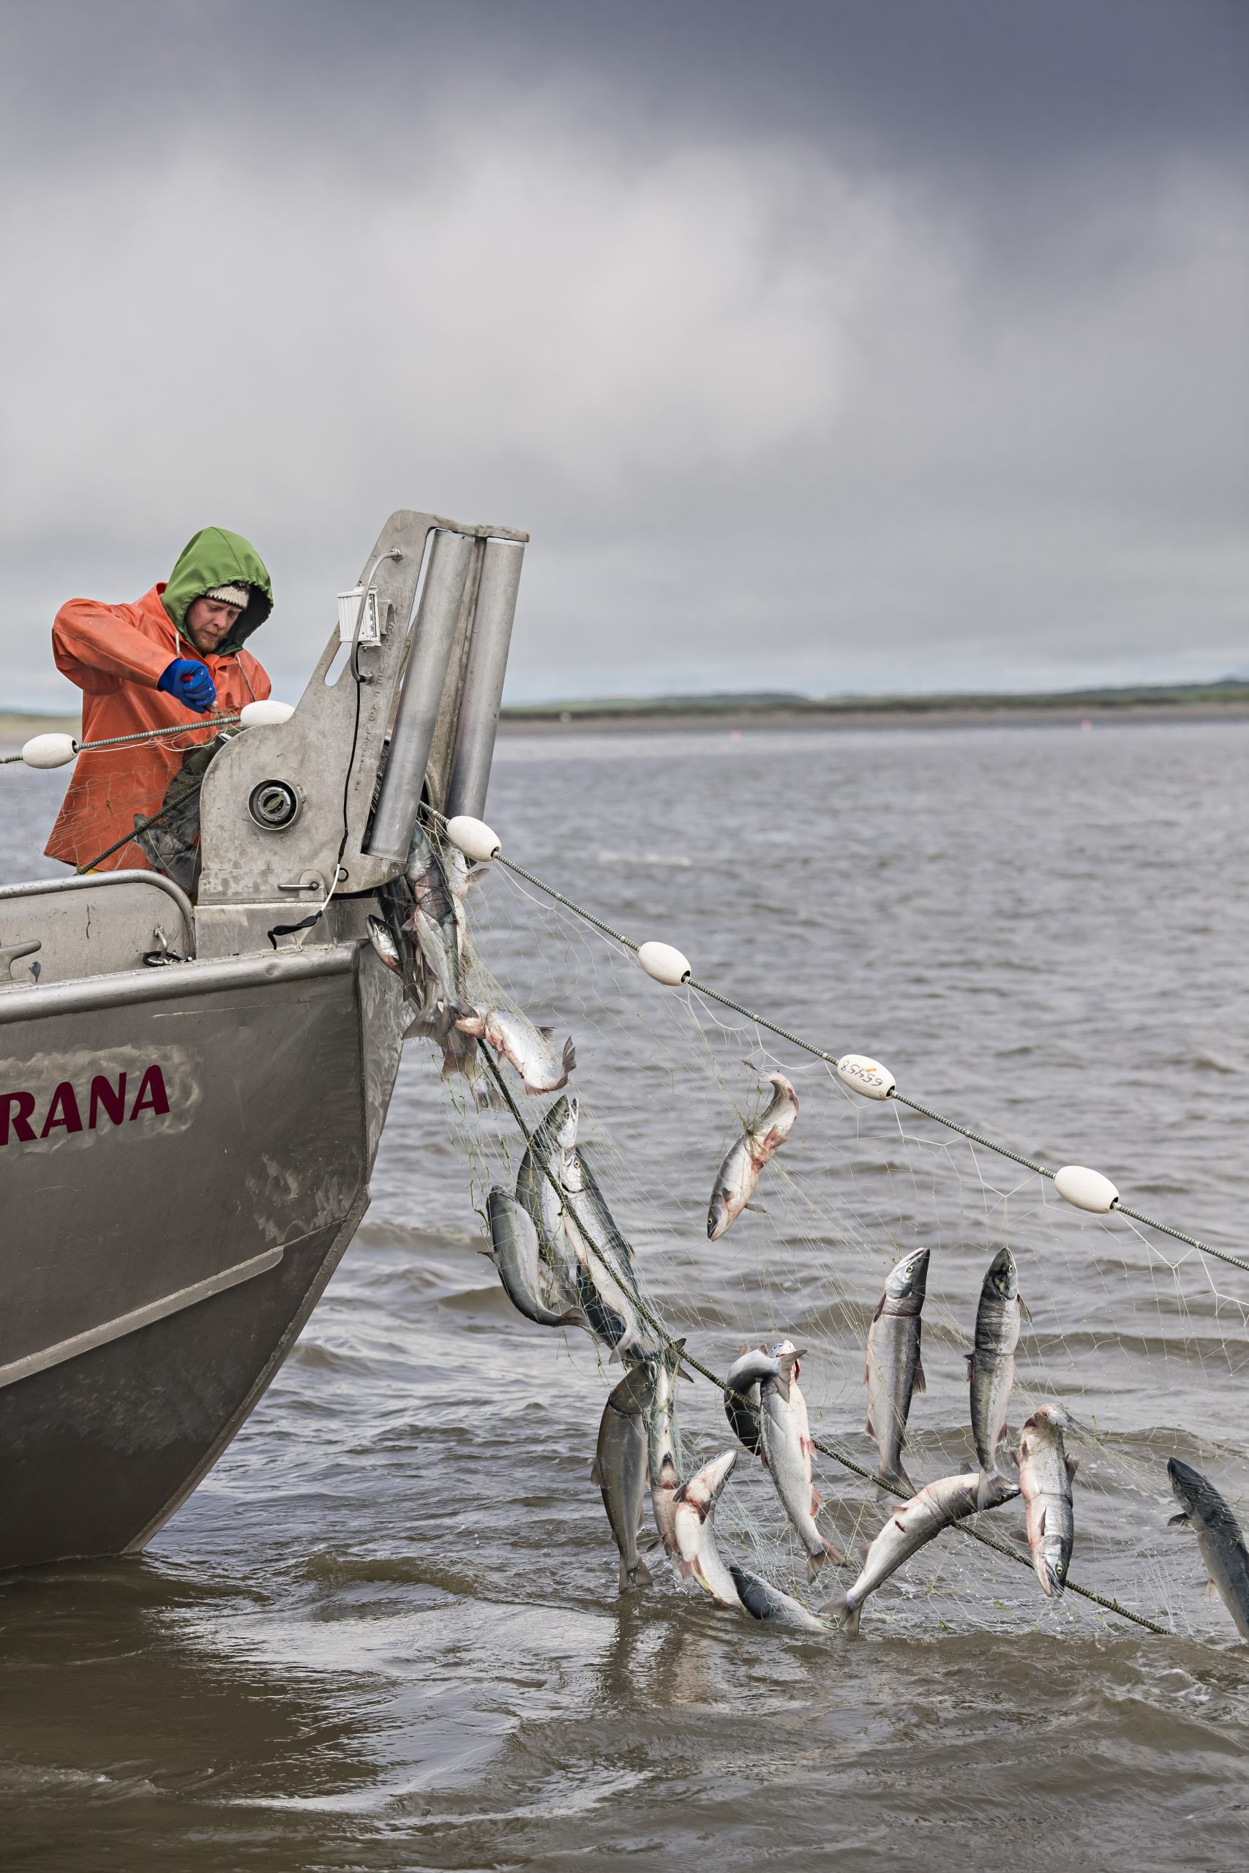

This puts managers in a bind... - Allow harvest - protect fish (rebuild stock) - Make sure this never happens again (climate adaptation and resilliance)

Slide 4
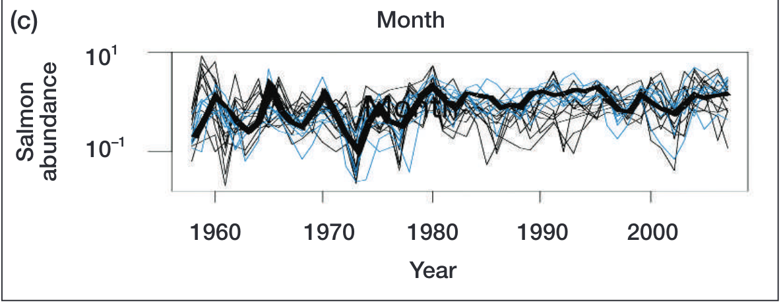
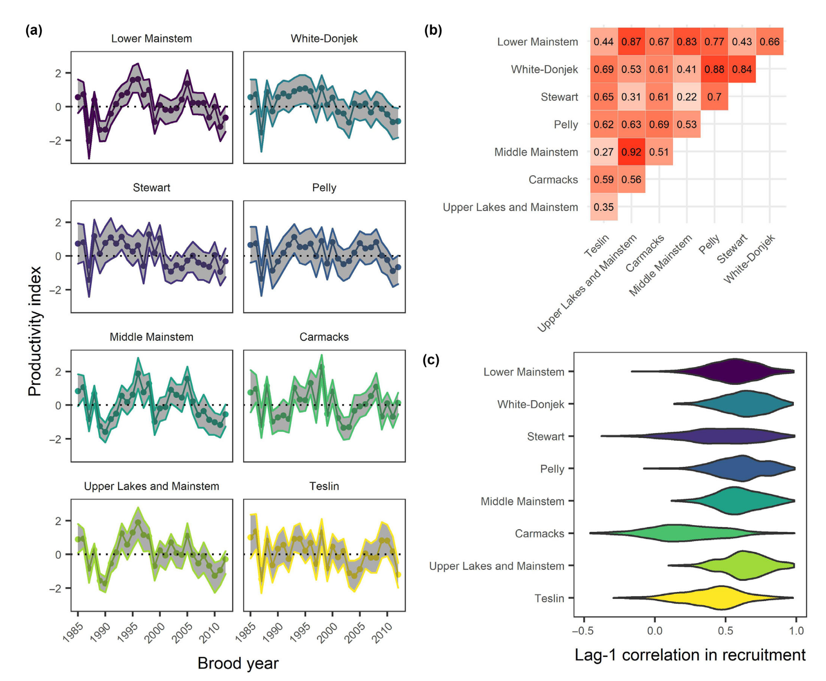
The ”Portfolio effect”
Natural variability (within and among systems, species, etc) “diversifies” assets similar to financial markets, dampens variation for the population
Weak or negative covariance among salmon metapopulation timing/production over space/time contributes towards population stability/resilliance to climate change

Slide 5
Assessing ecosystem health needs to incorporate the health of each component, not overall abundance

Slide 6
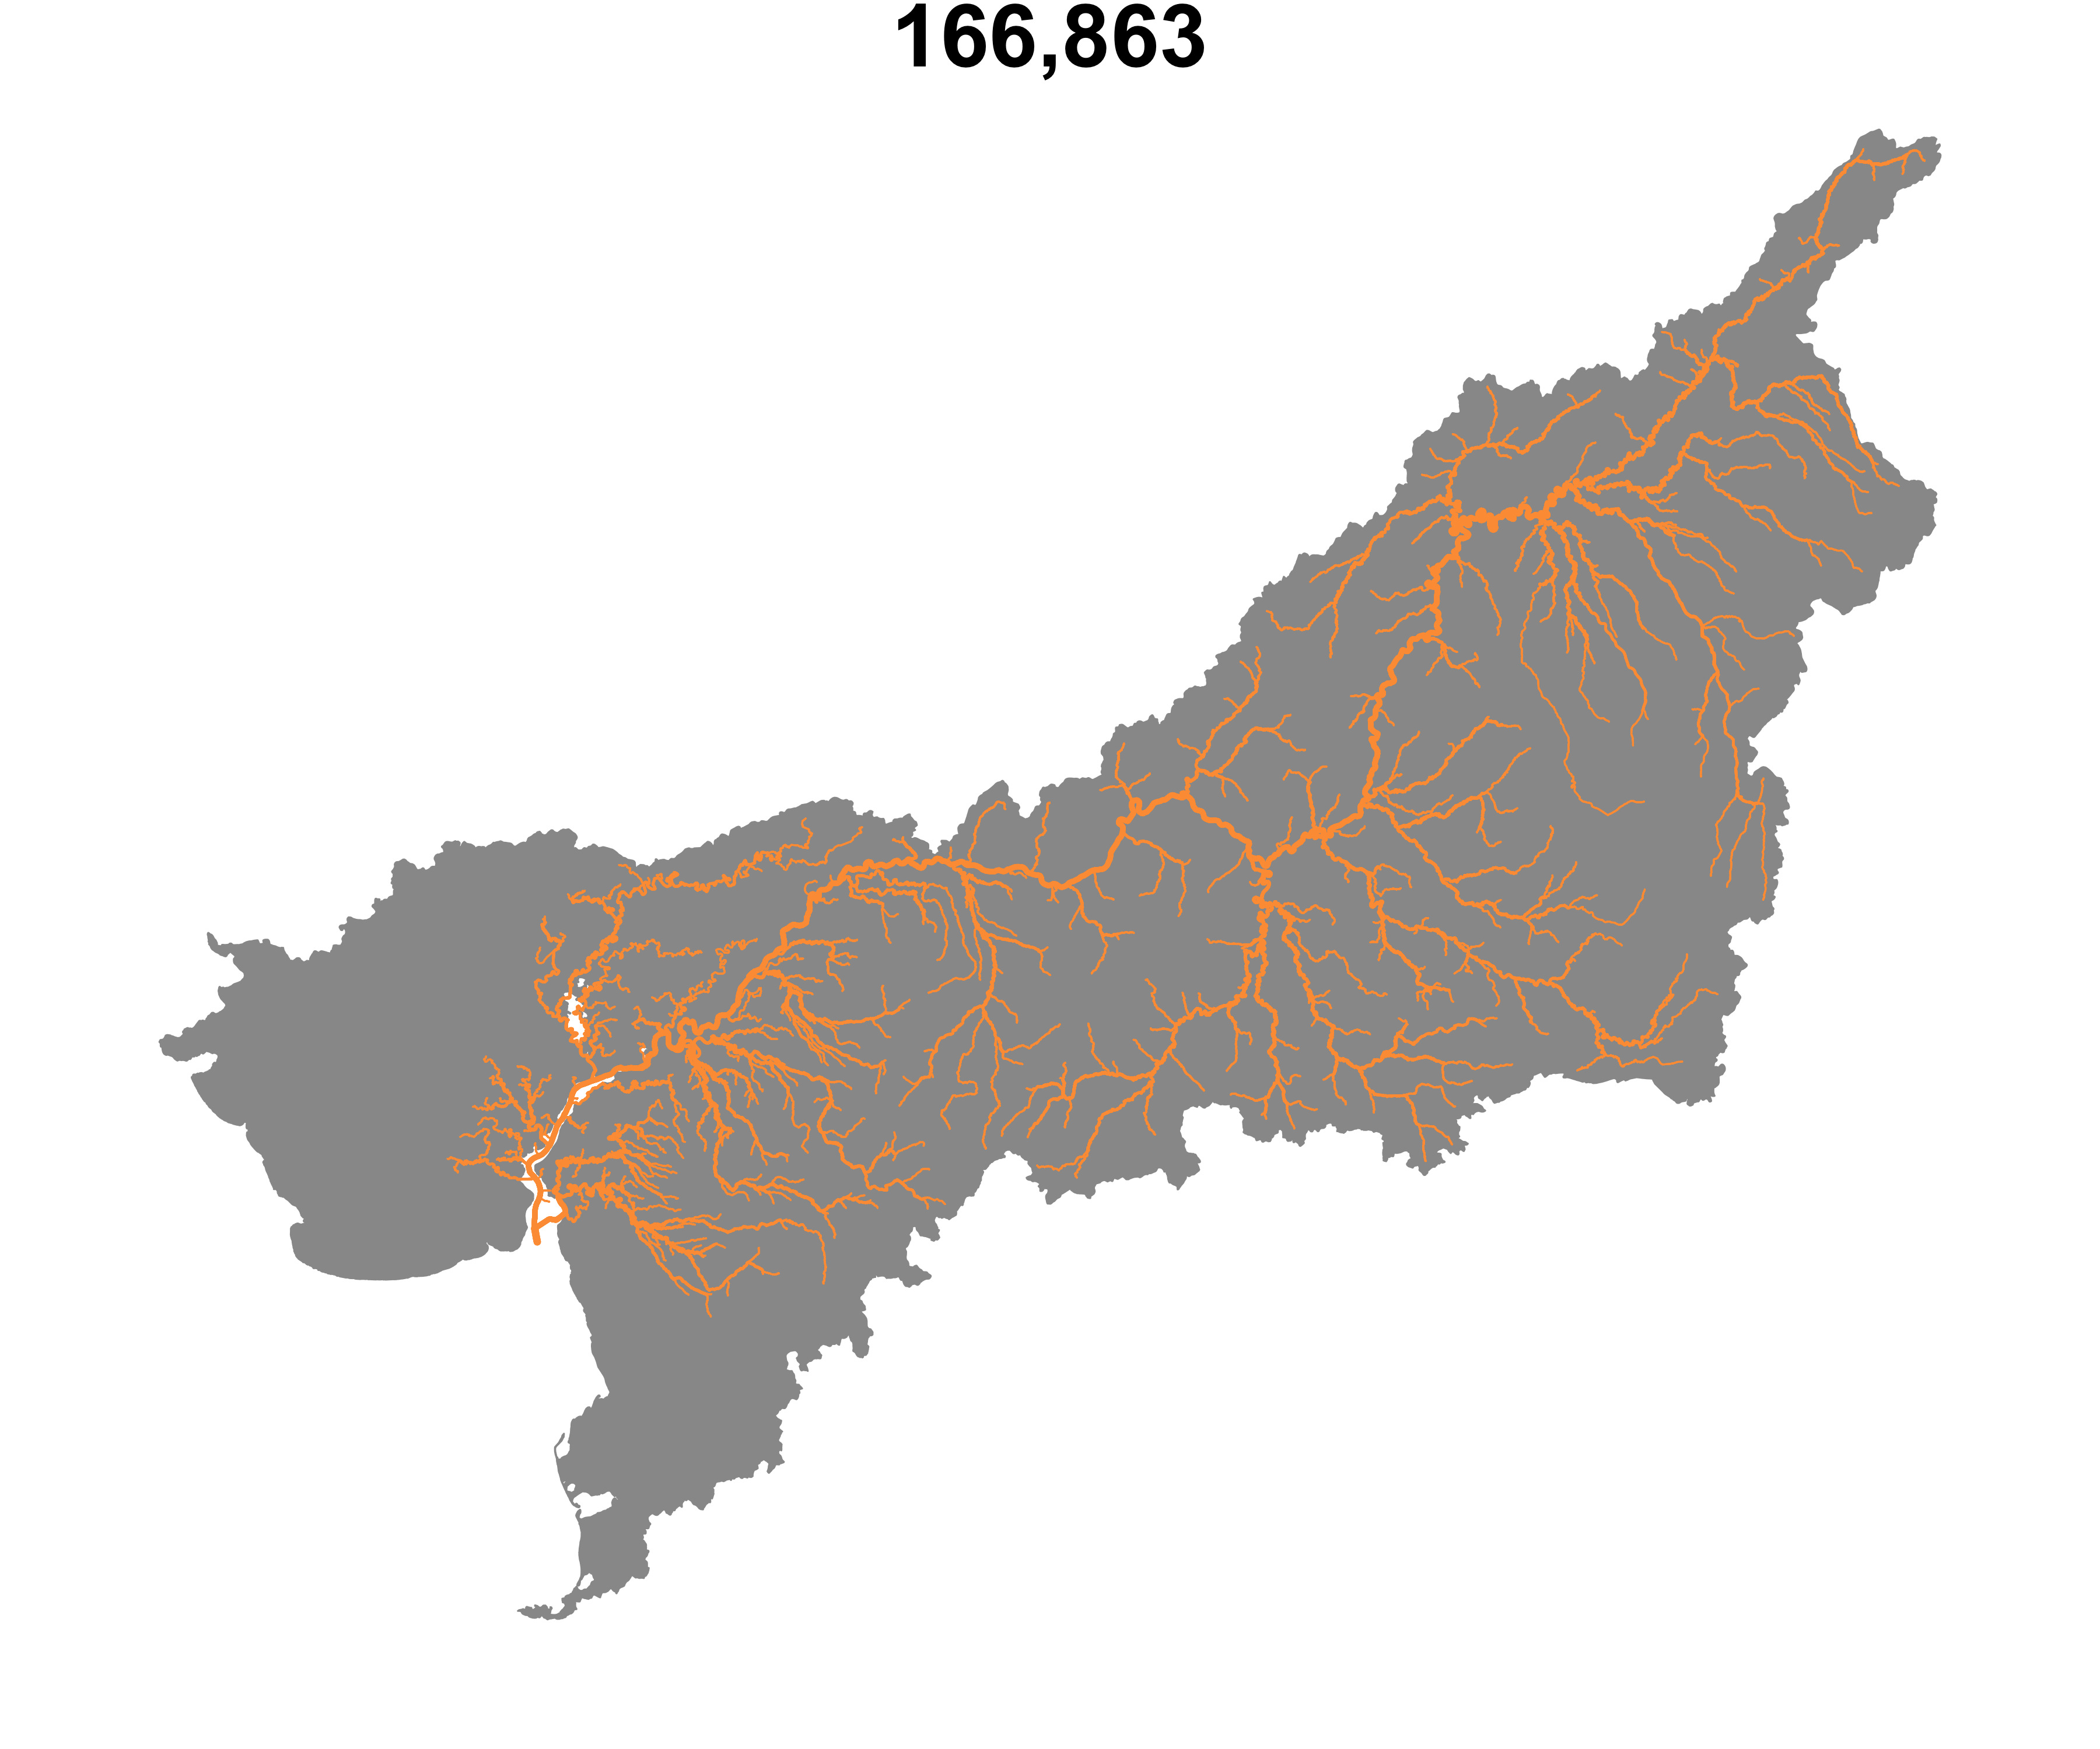
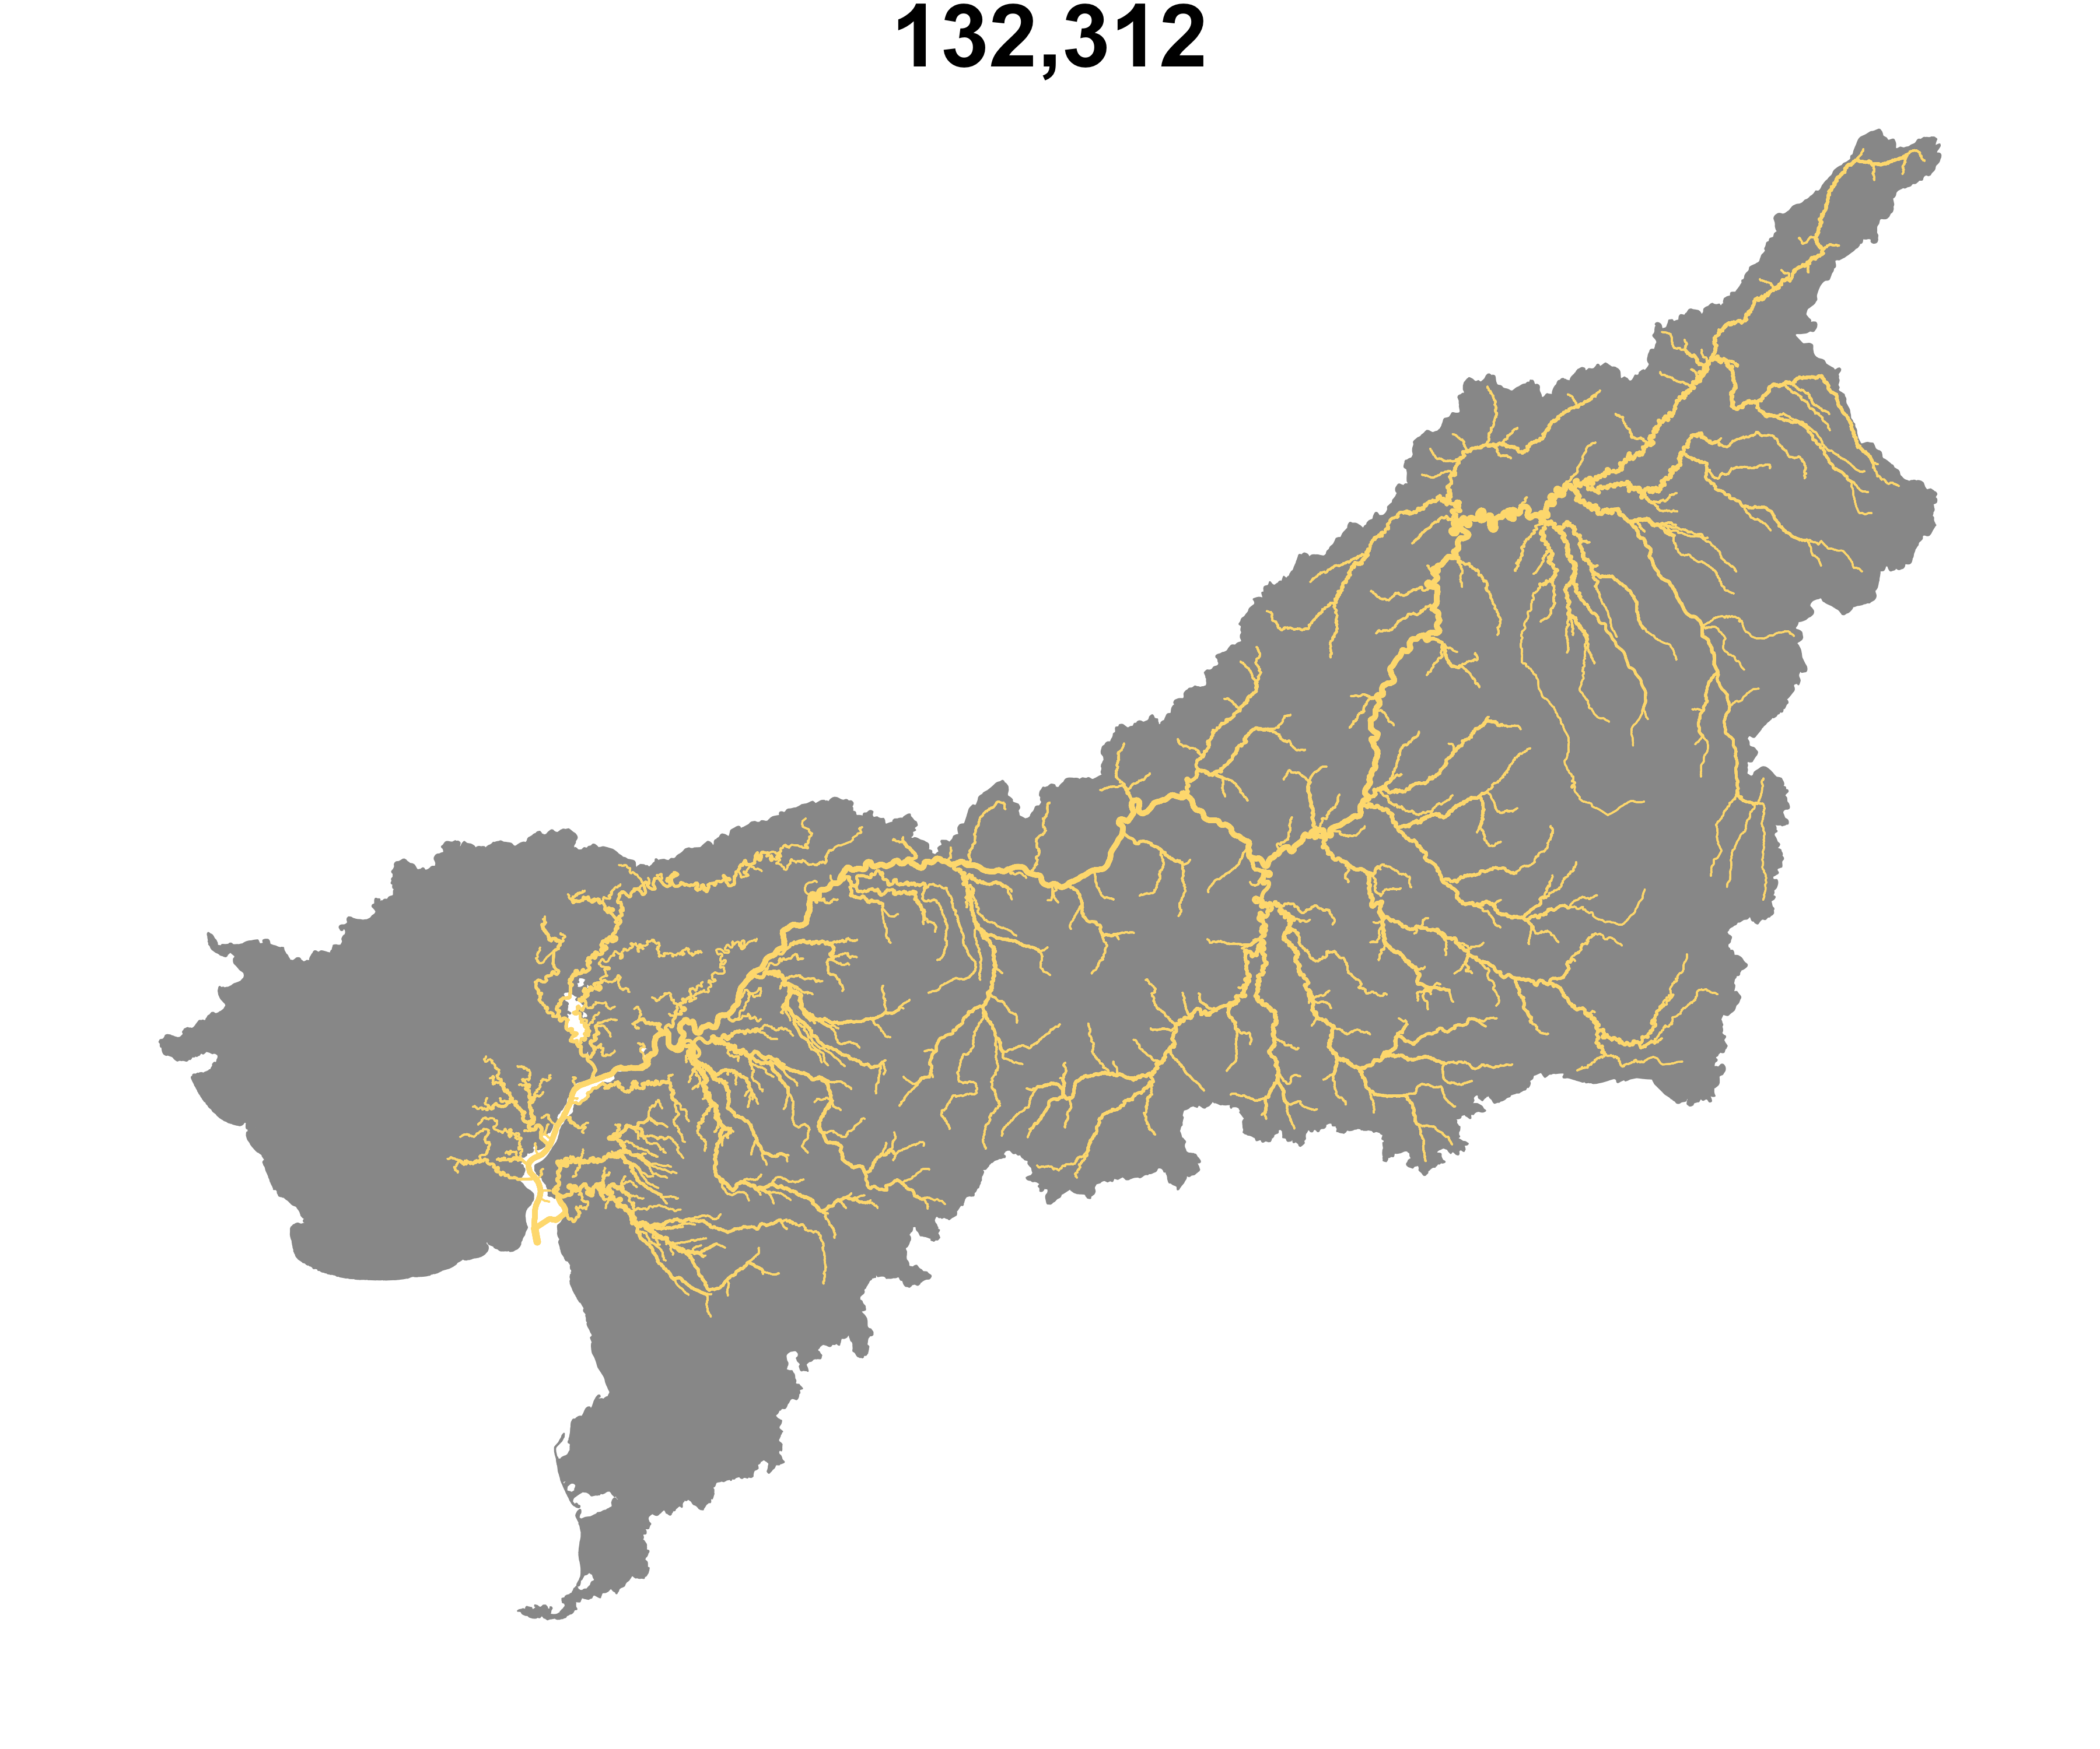
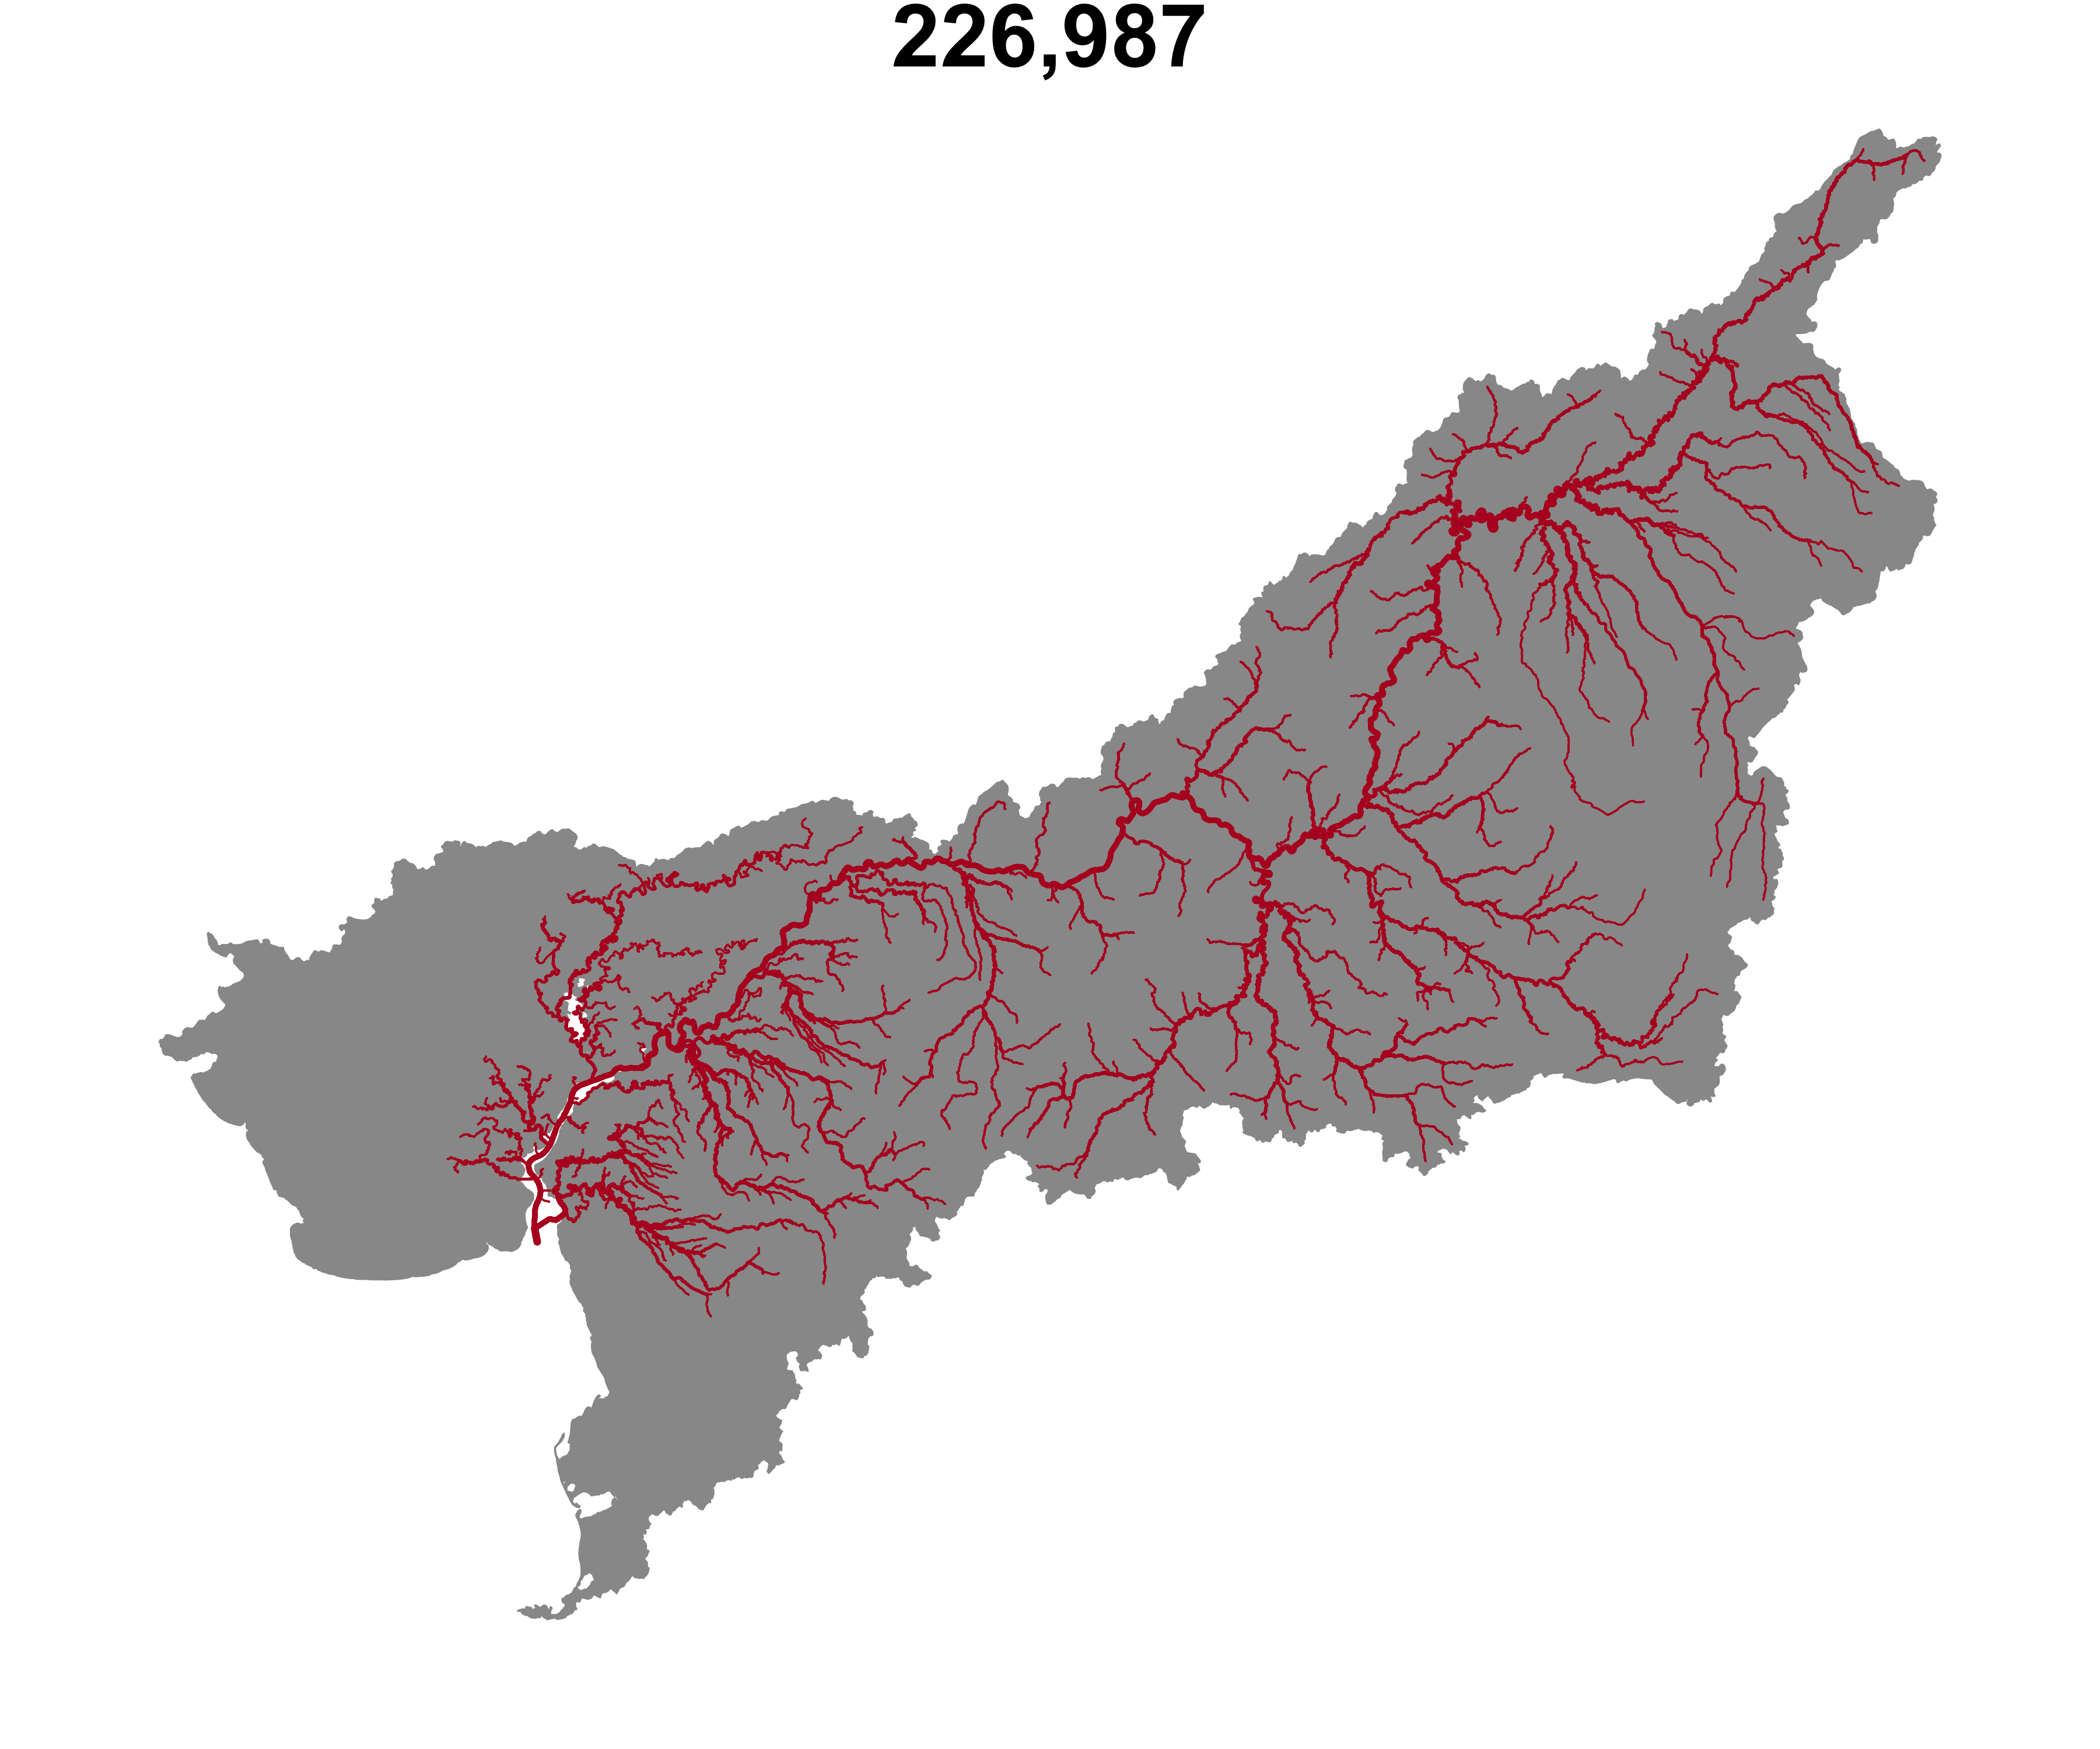


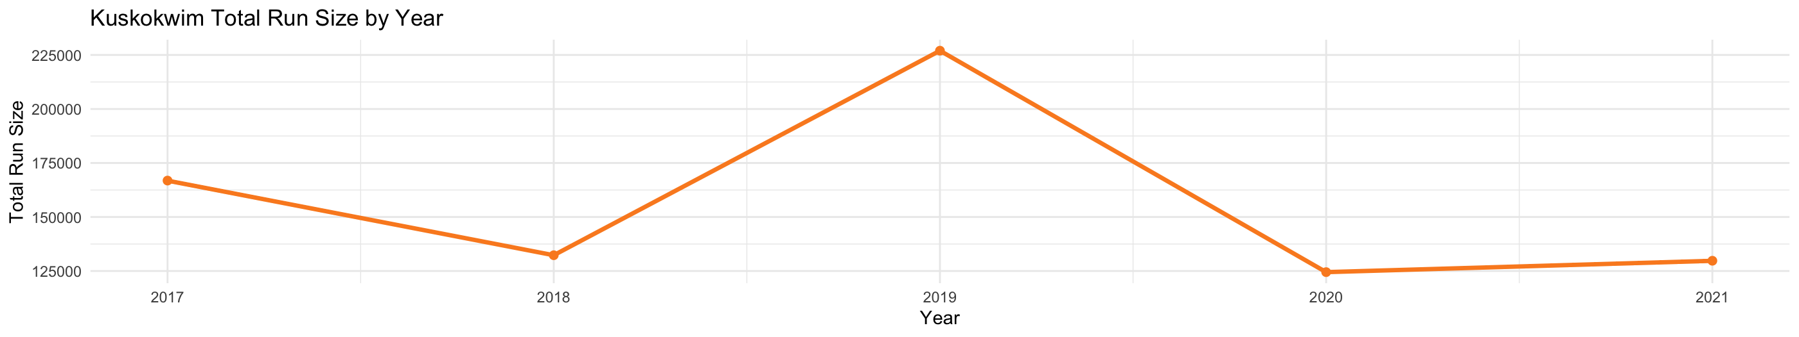
Assessing ecosystem health needs to incorporate the health of each component, not overall abundance

Slide 7

Currently almost no understanding of spatial distribution/timing in the Kuskokwim

Slide 8
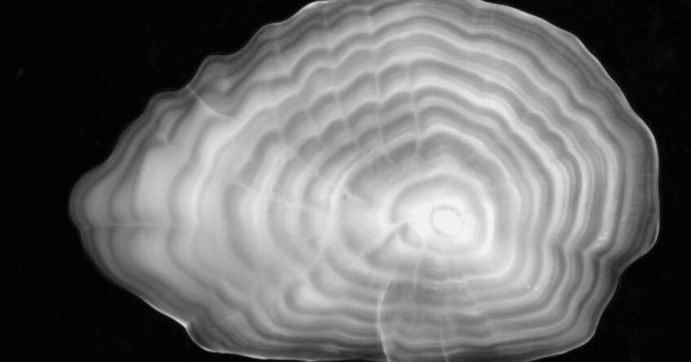
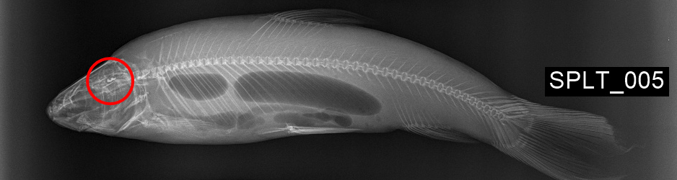
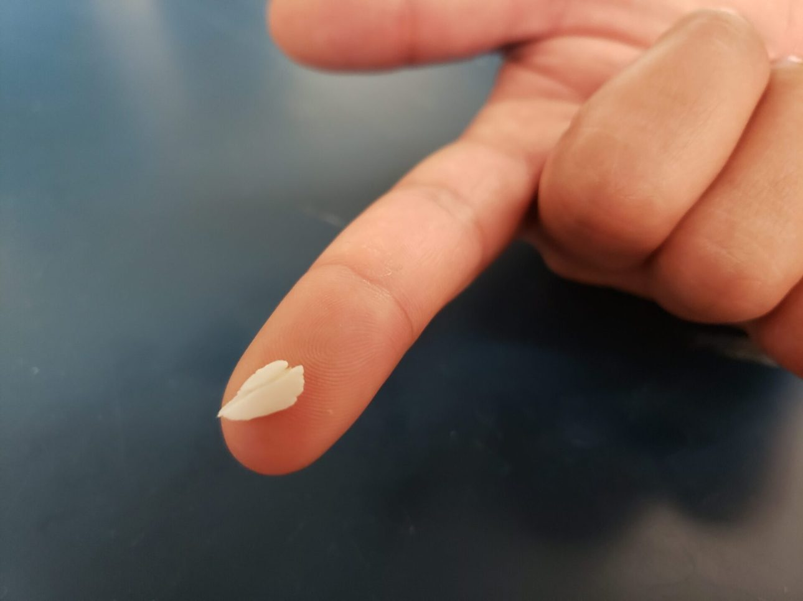
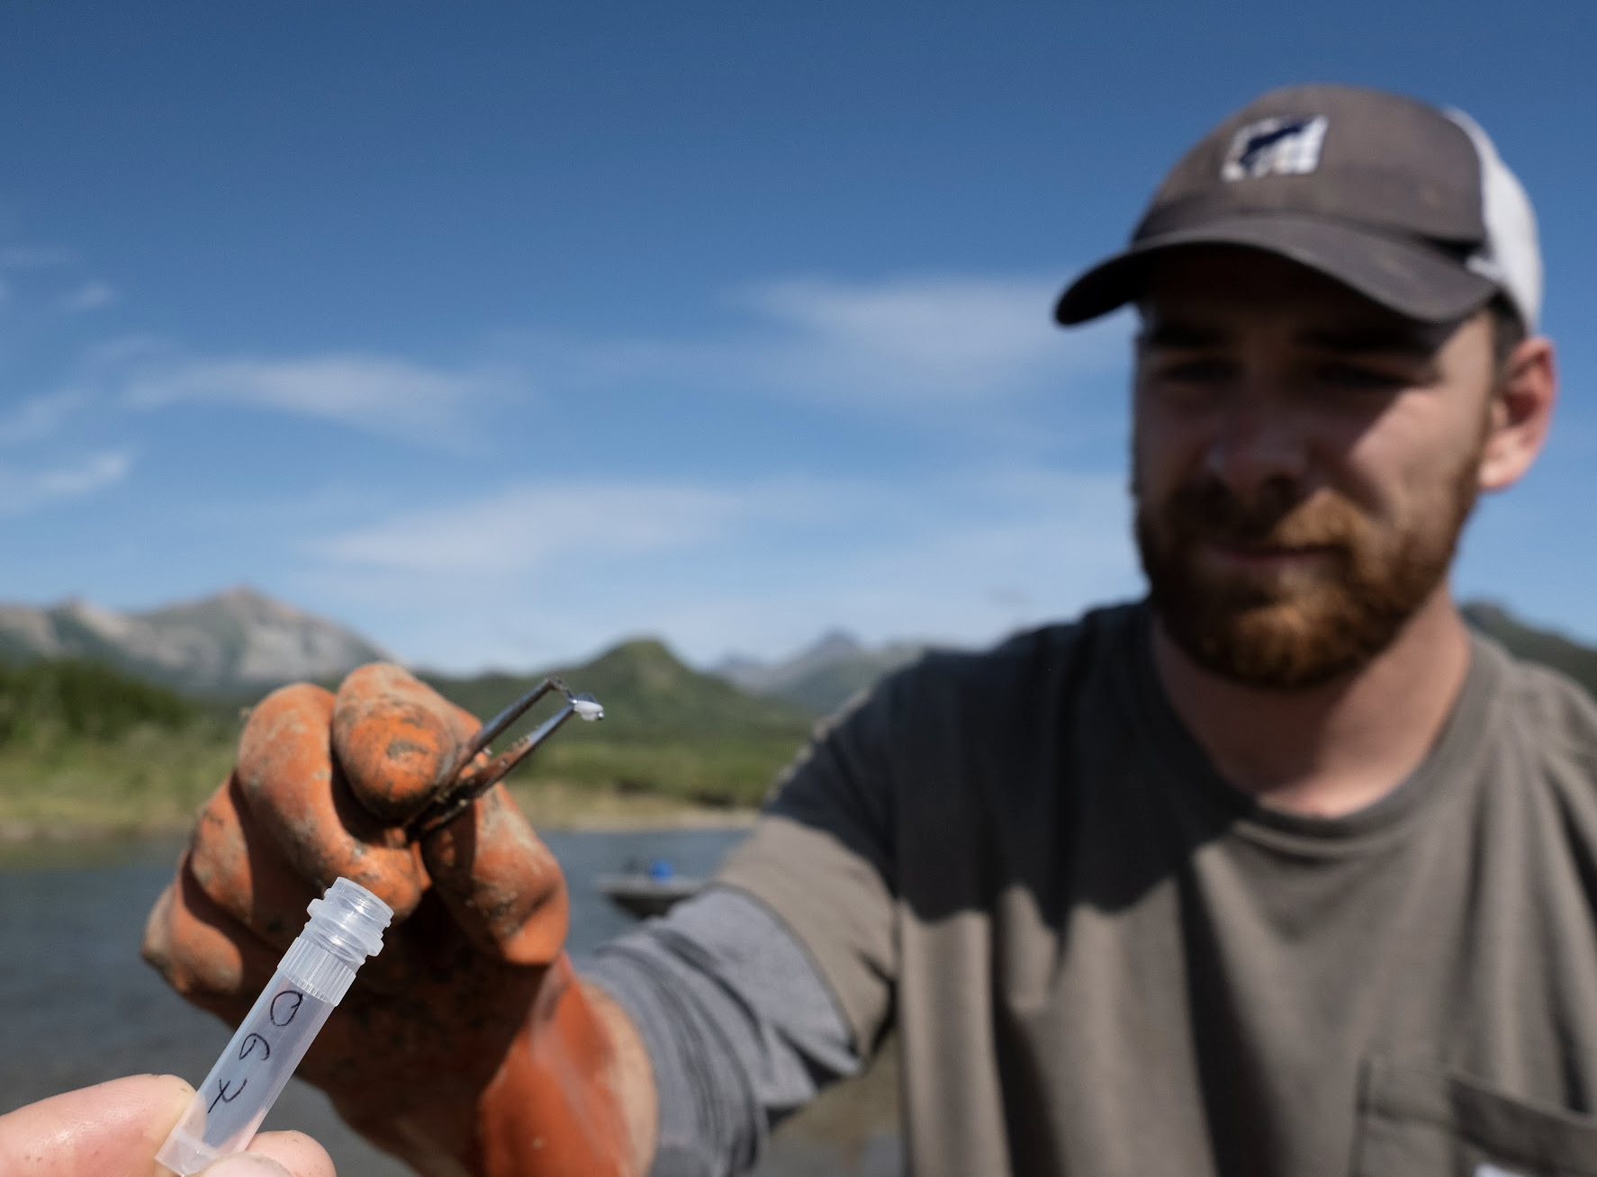
Otoliths
; a “time capsule”
Notes:
... so we use otoliths...

Slide 9
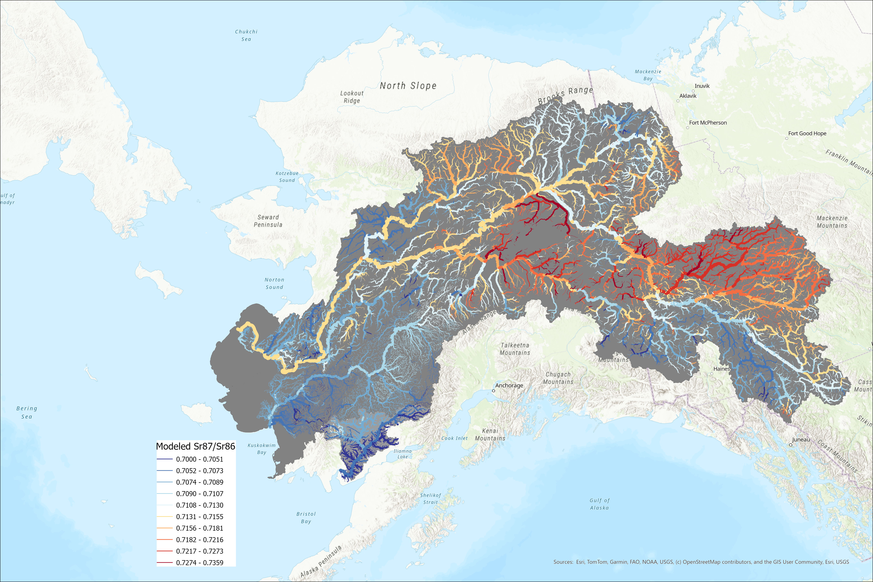
Strontium
Sr⁸⁷/Sr⁸⁶
Notes:
Precise estimate

Slide 10

5 years of otolith samples,
Currently almost no understanding of spatial distribution/timing in the Kuskokwim
Kuskokwim

Slide 11
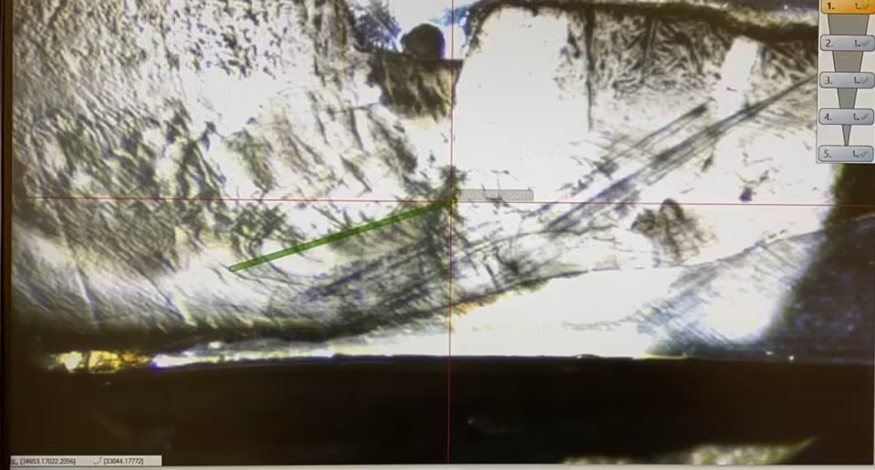
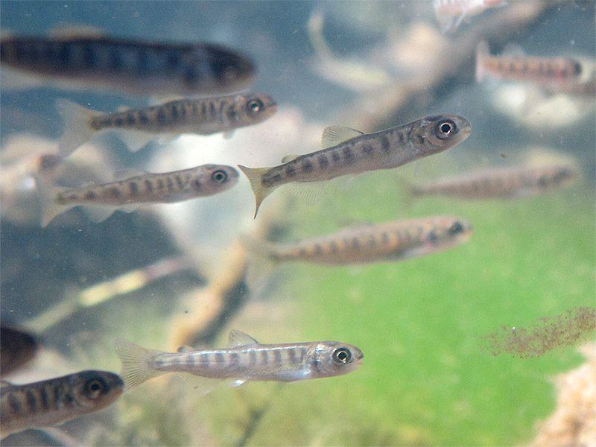
Notes:
Stress why people USUALLY look at just one

Slide 12
Within year run timing
Returns * CPUE over time by quartile, trib scale.

Slide 13
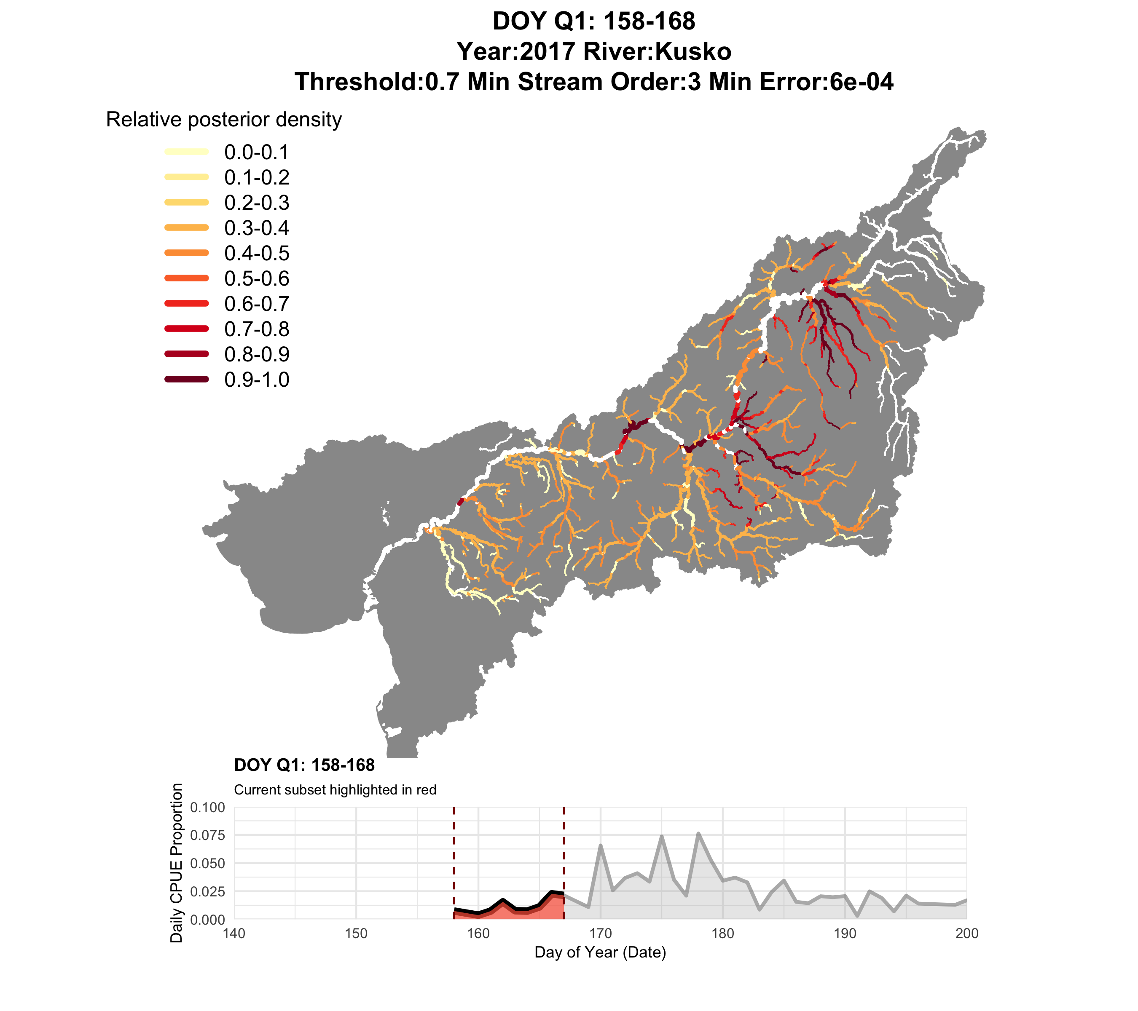

Slide 14
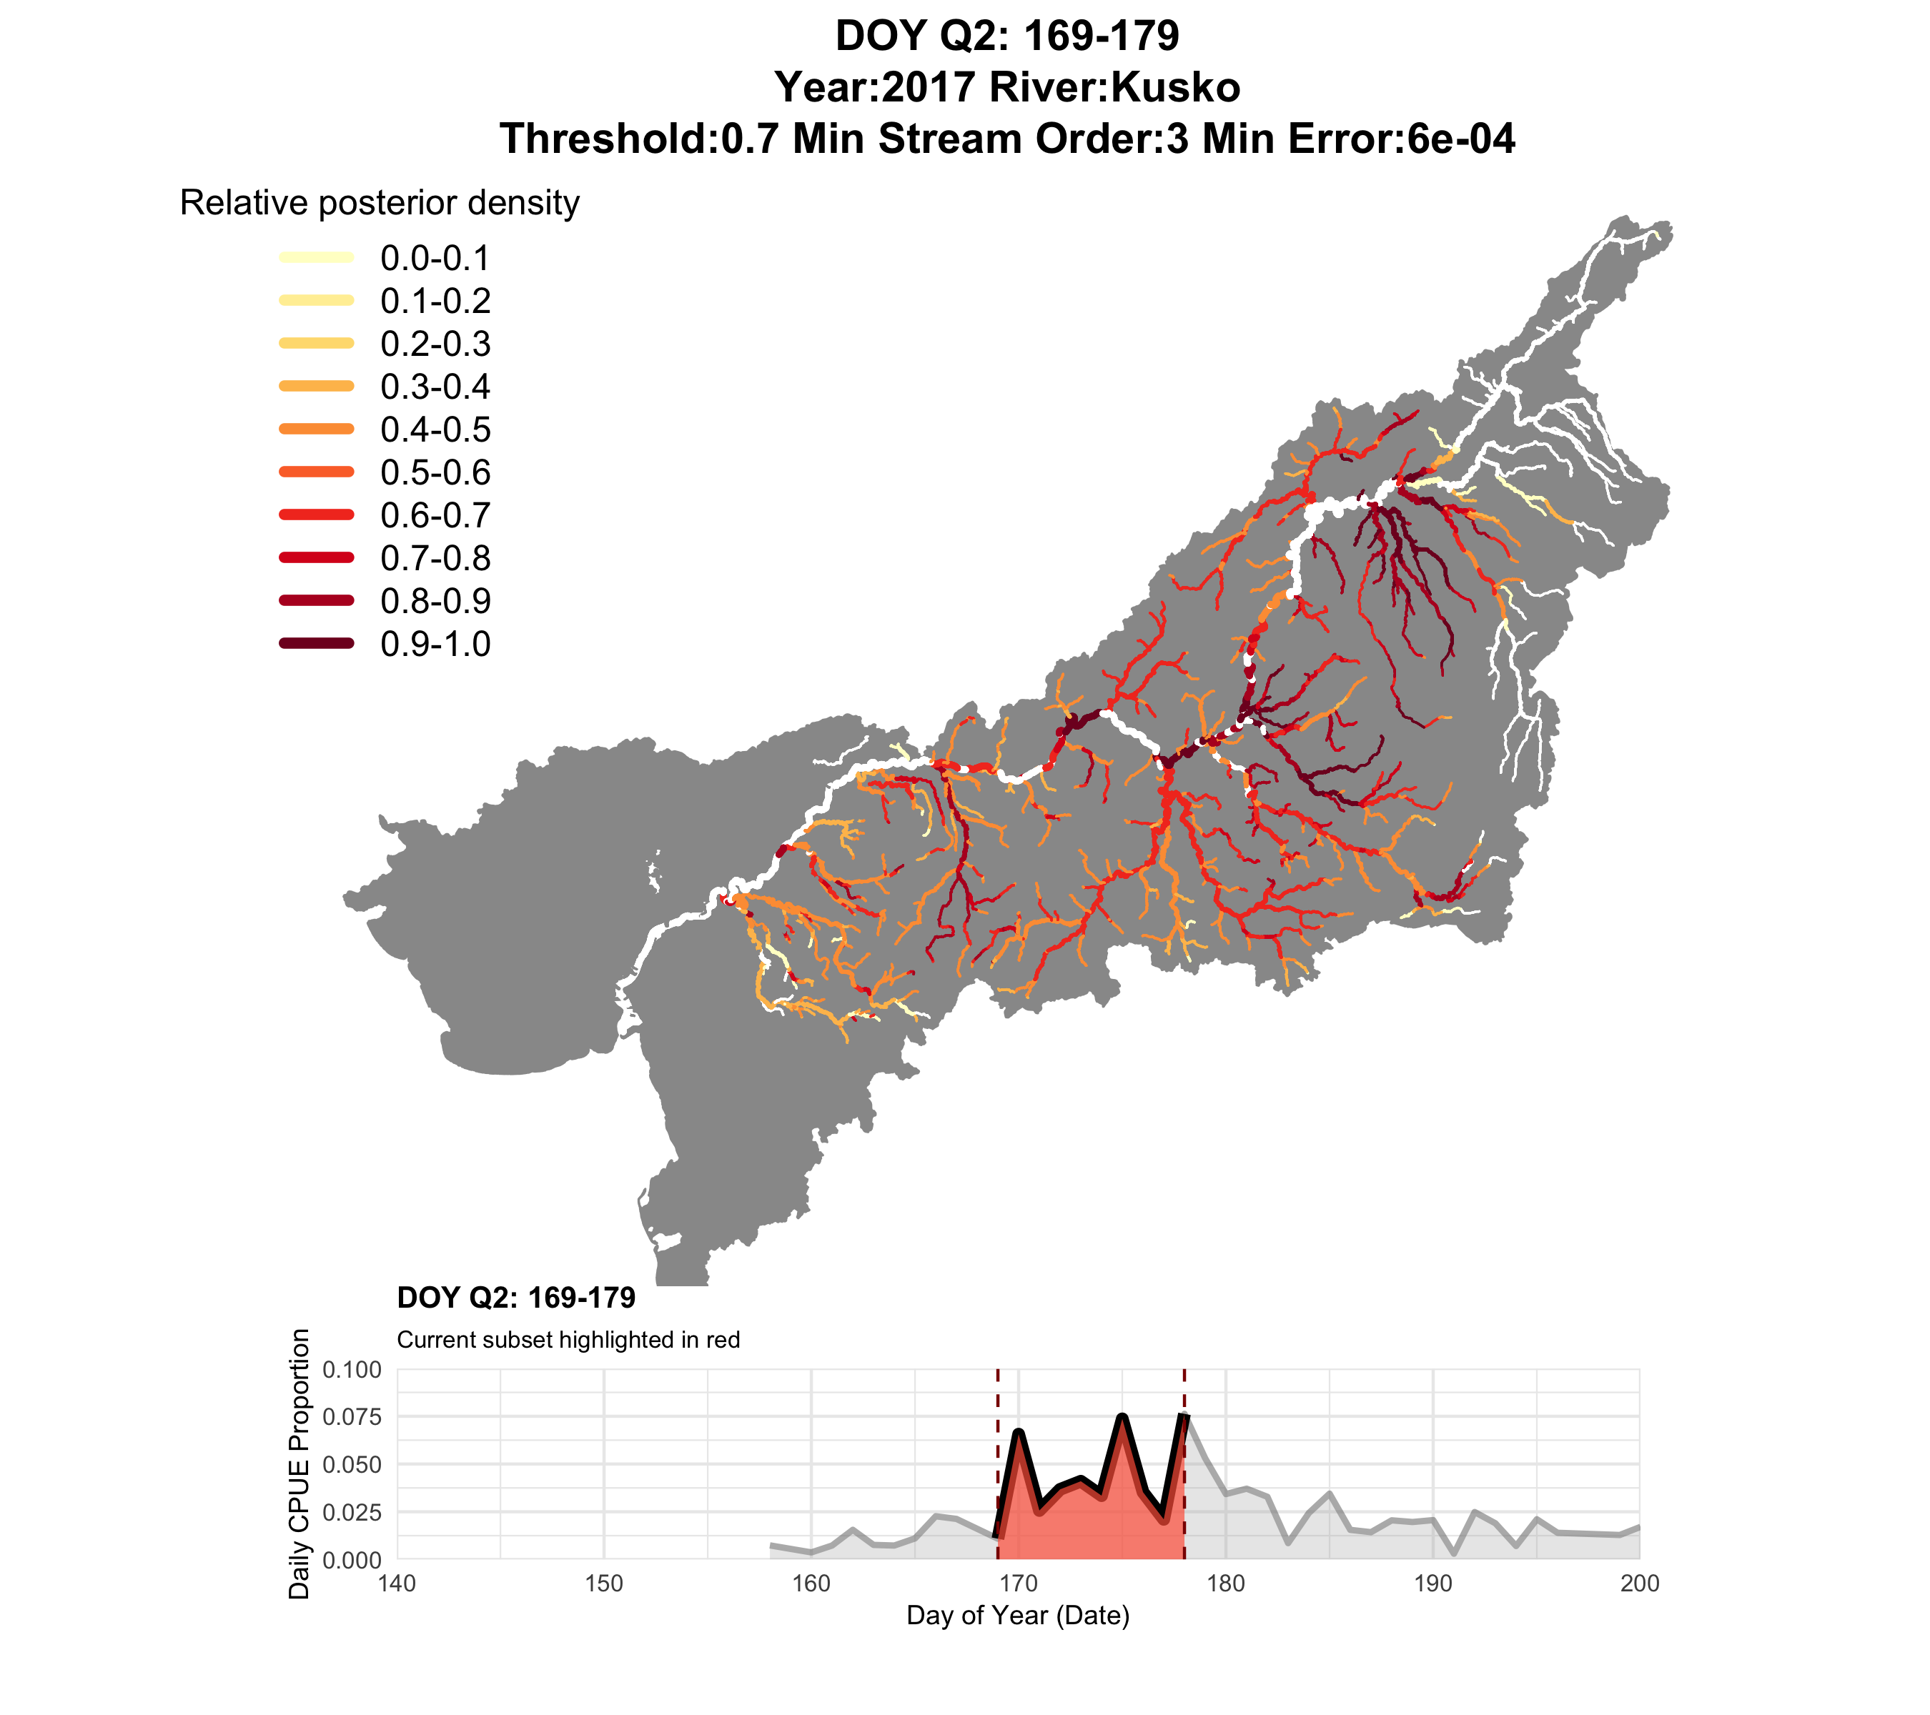

Slide 15
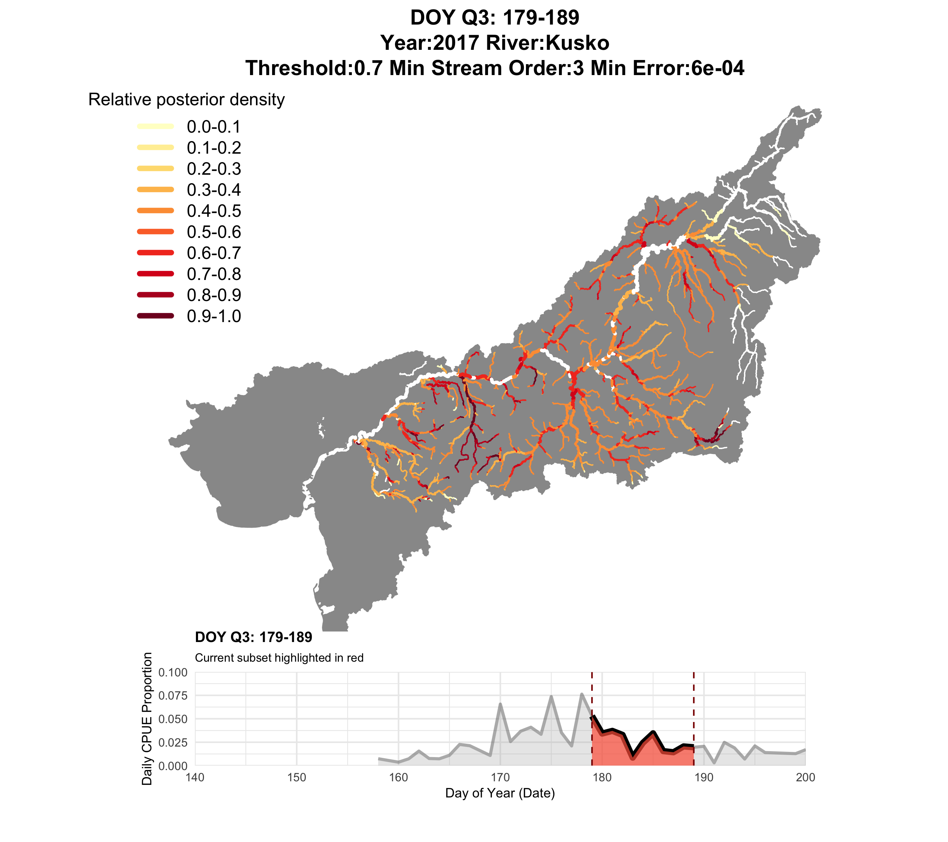

Slide 16
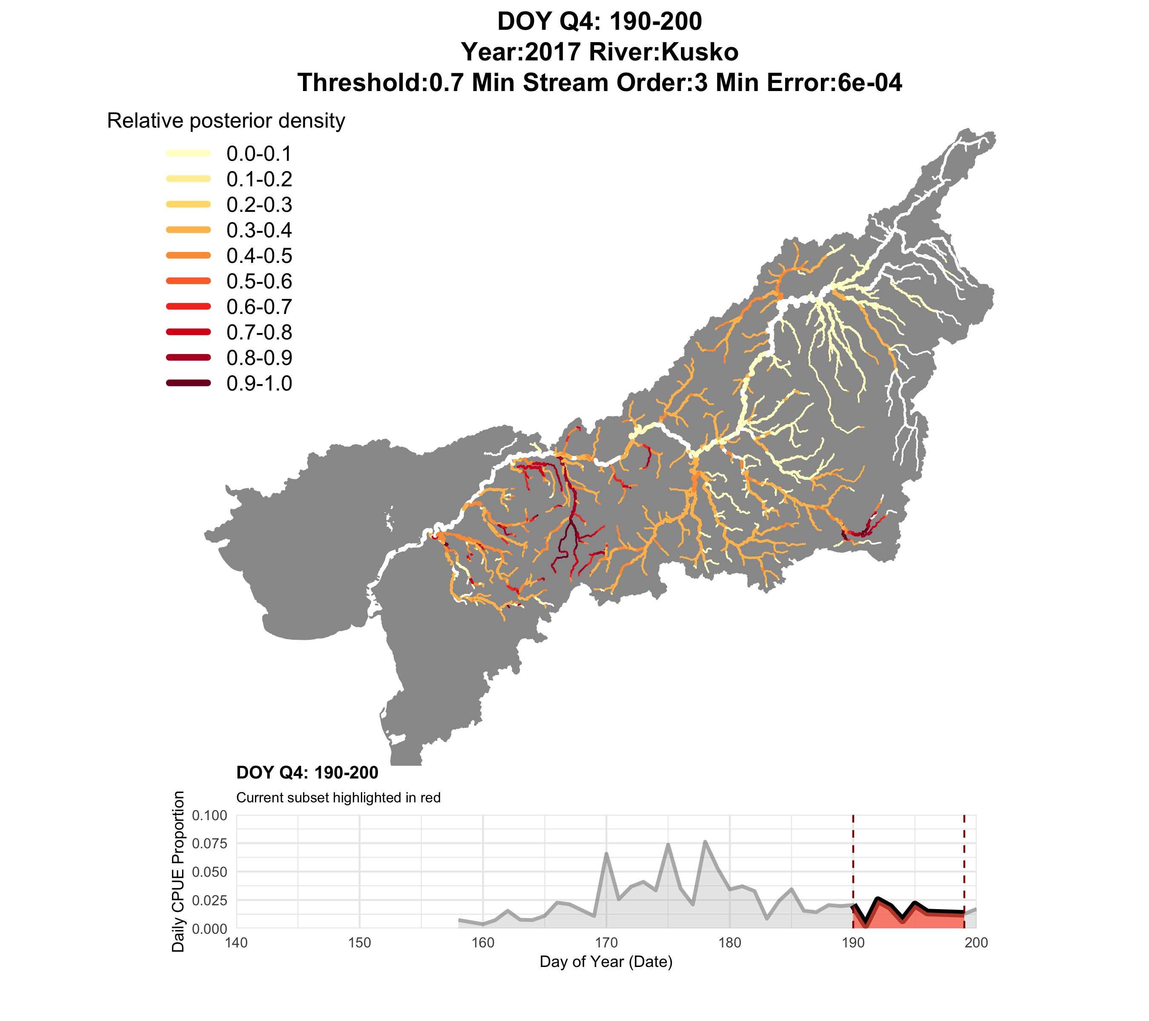

Slide 17


Slide 18
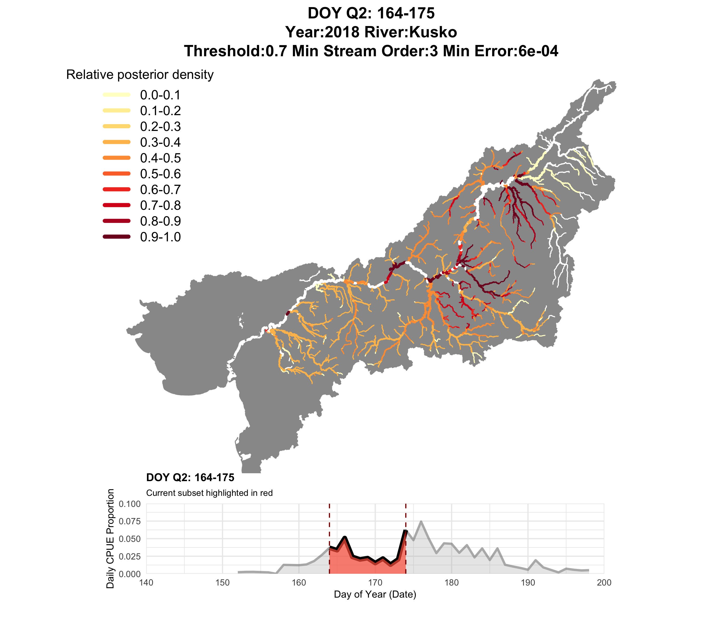

Slide 19
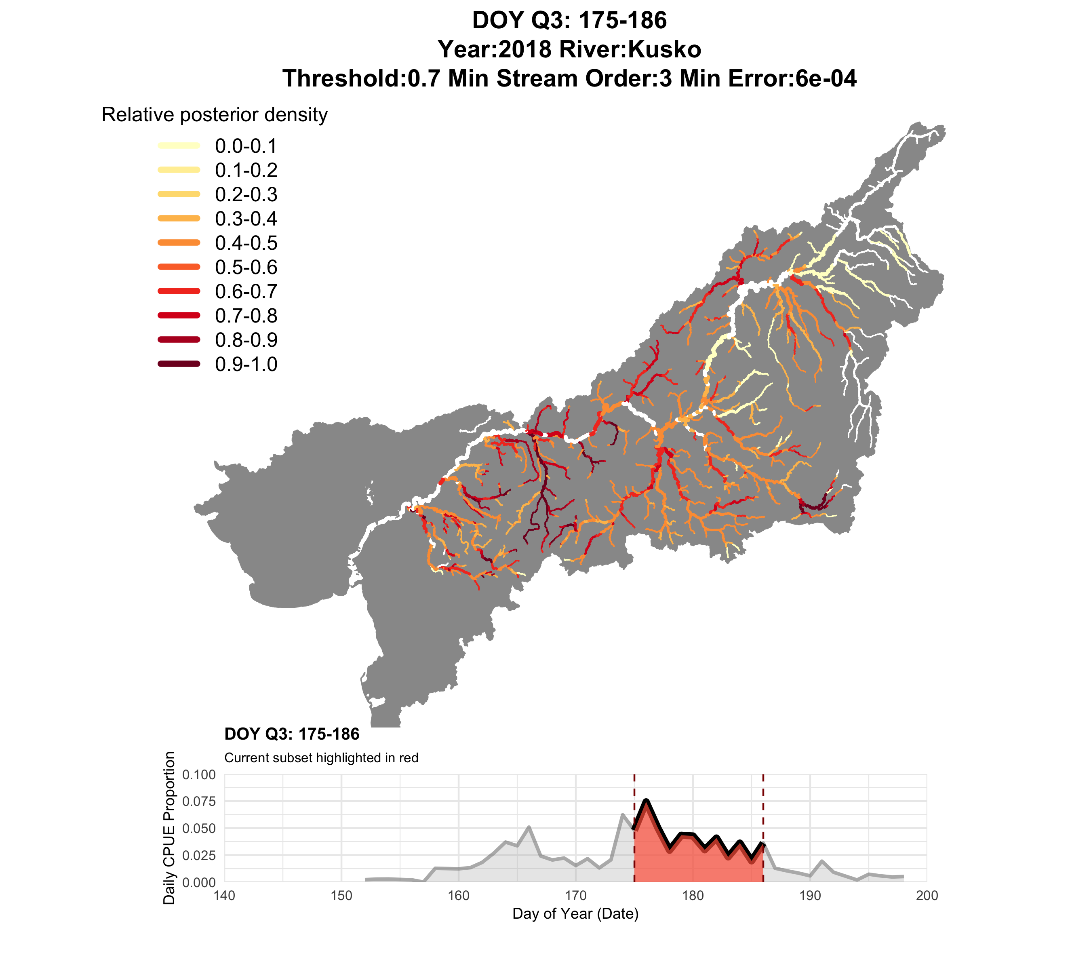

Slide 20
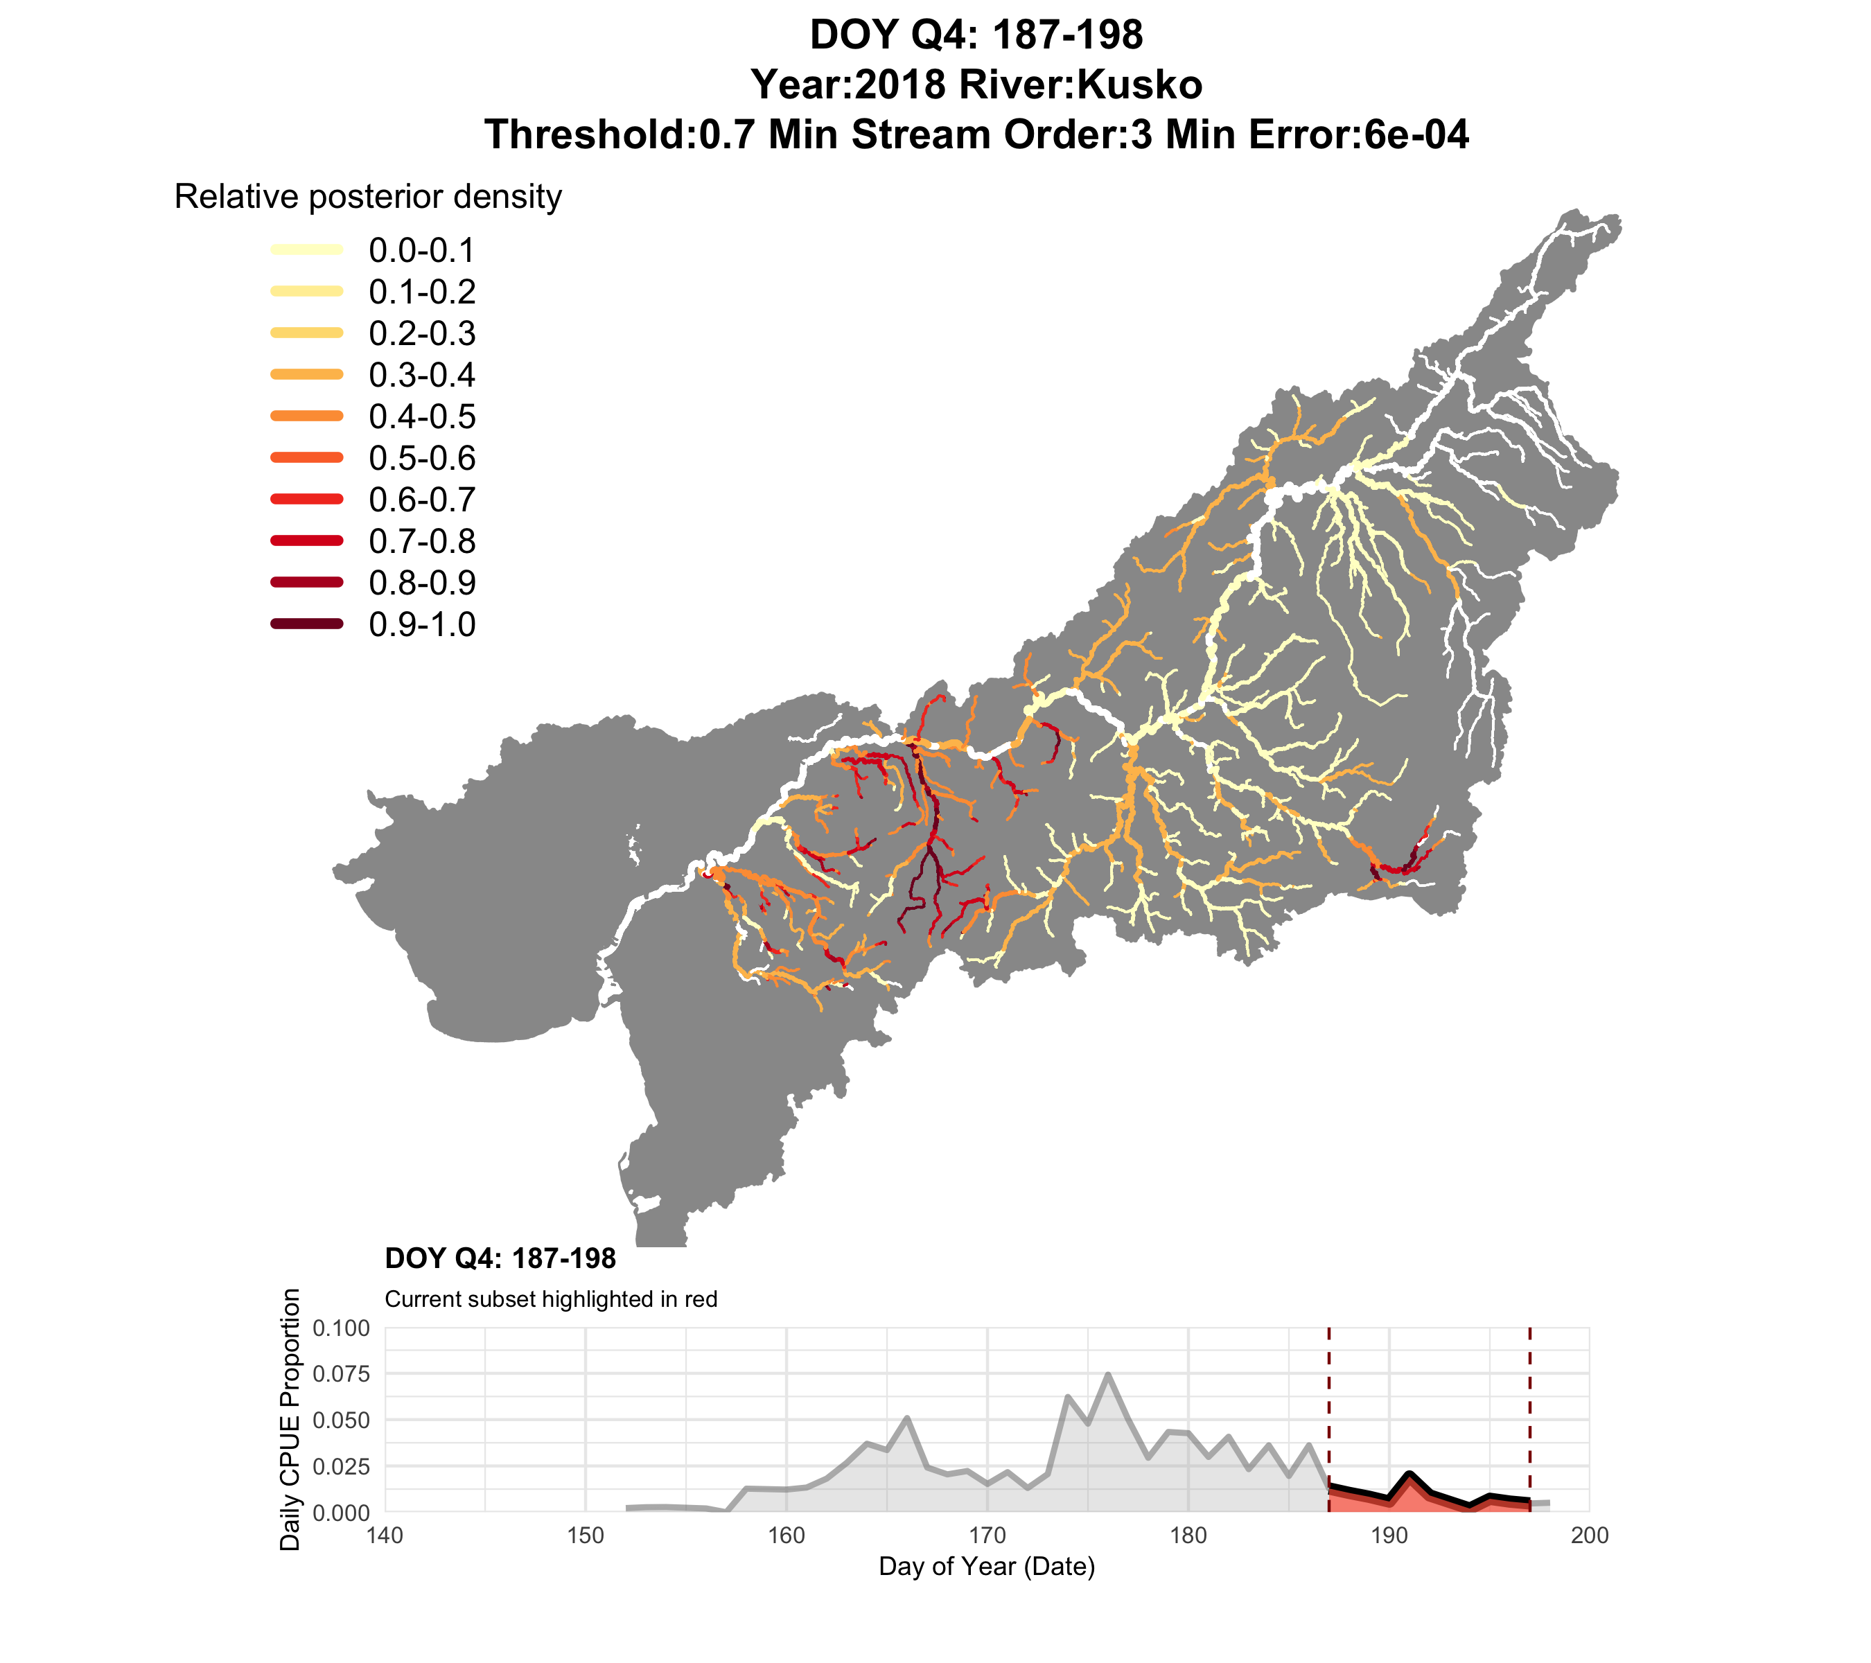

Slide 21


Slide 22
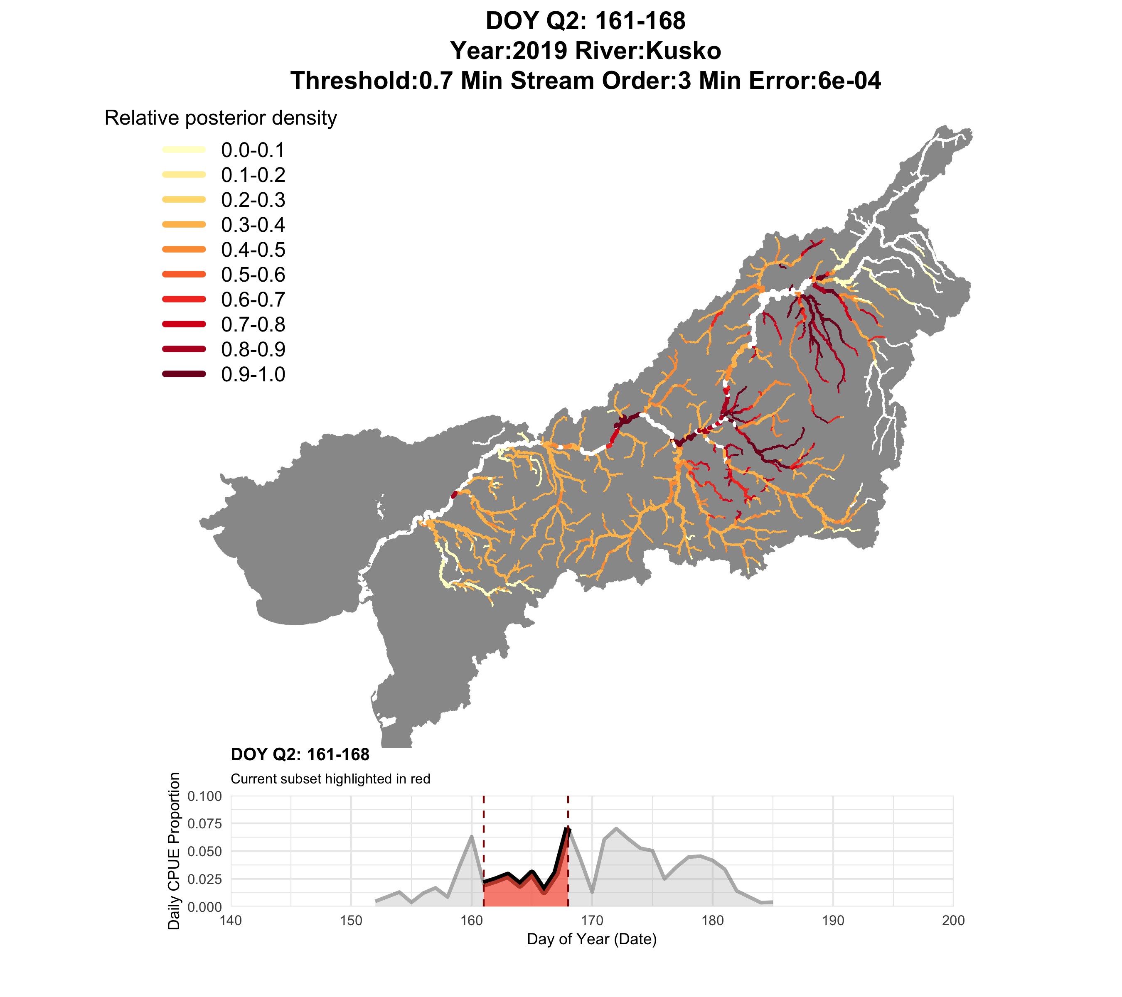

Slide 23
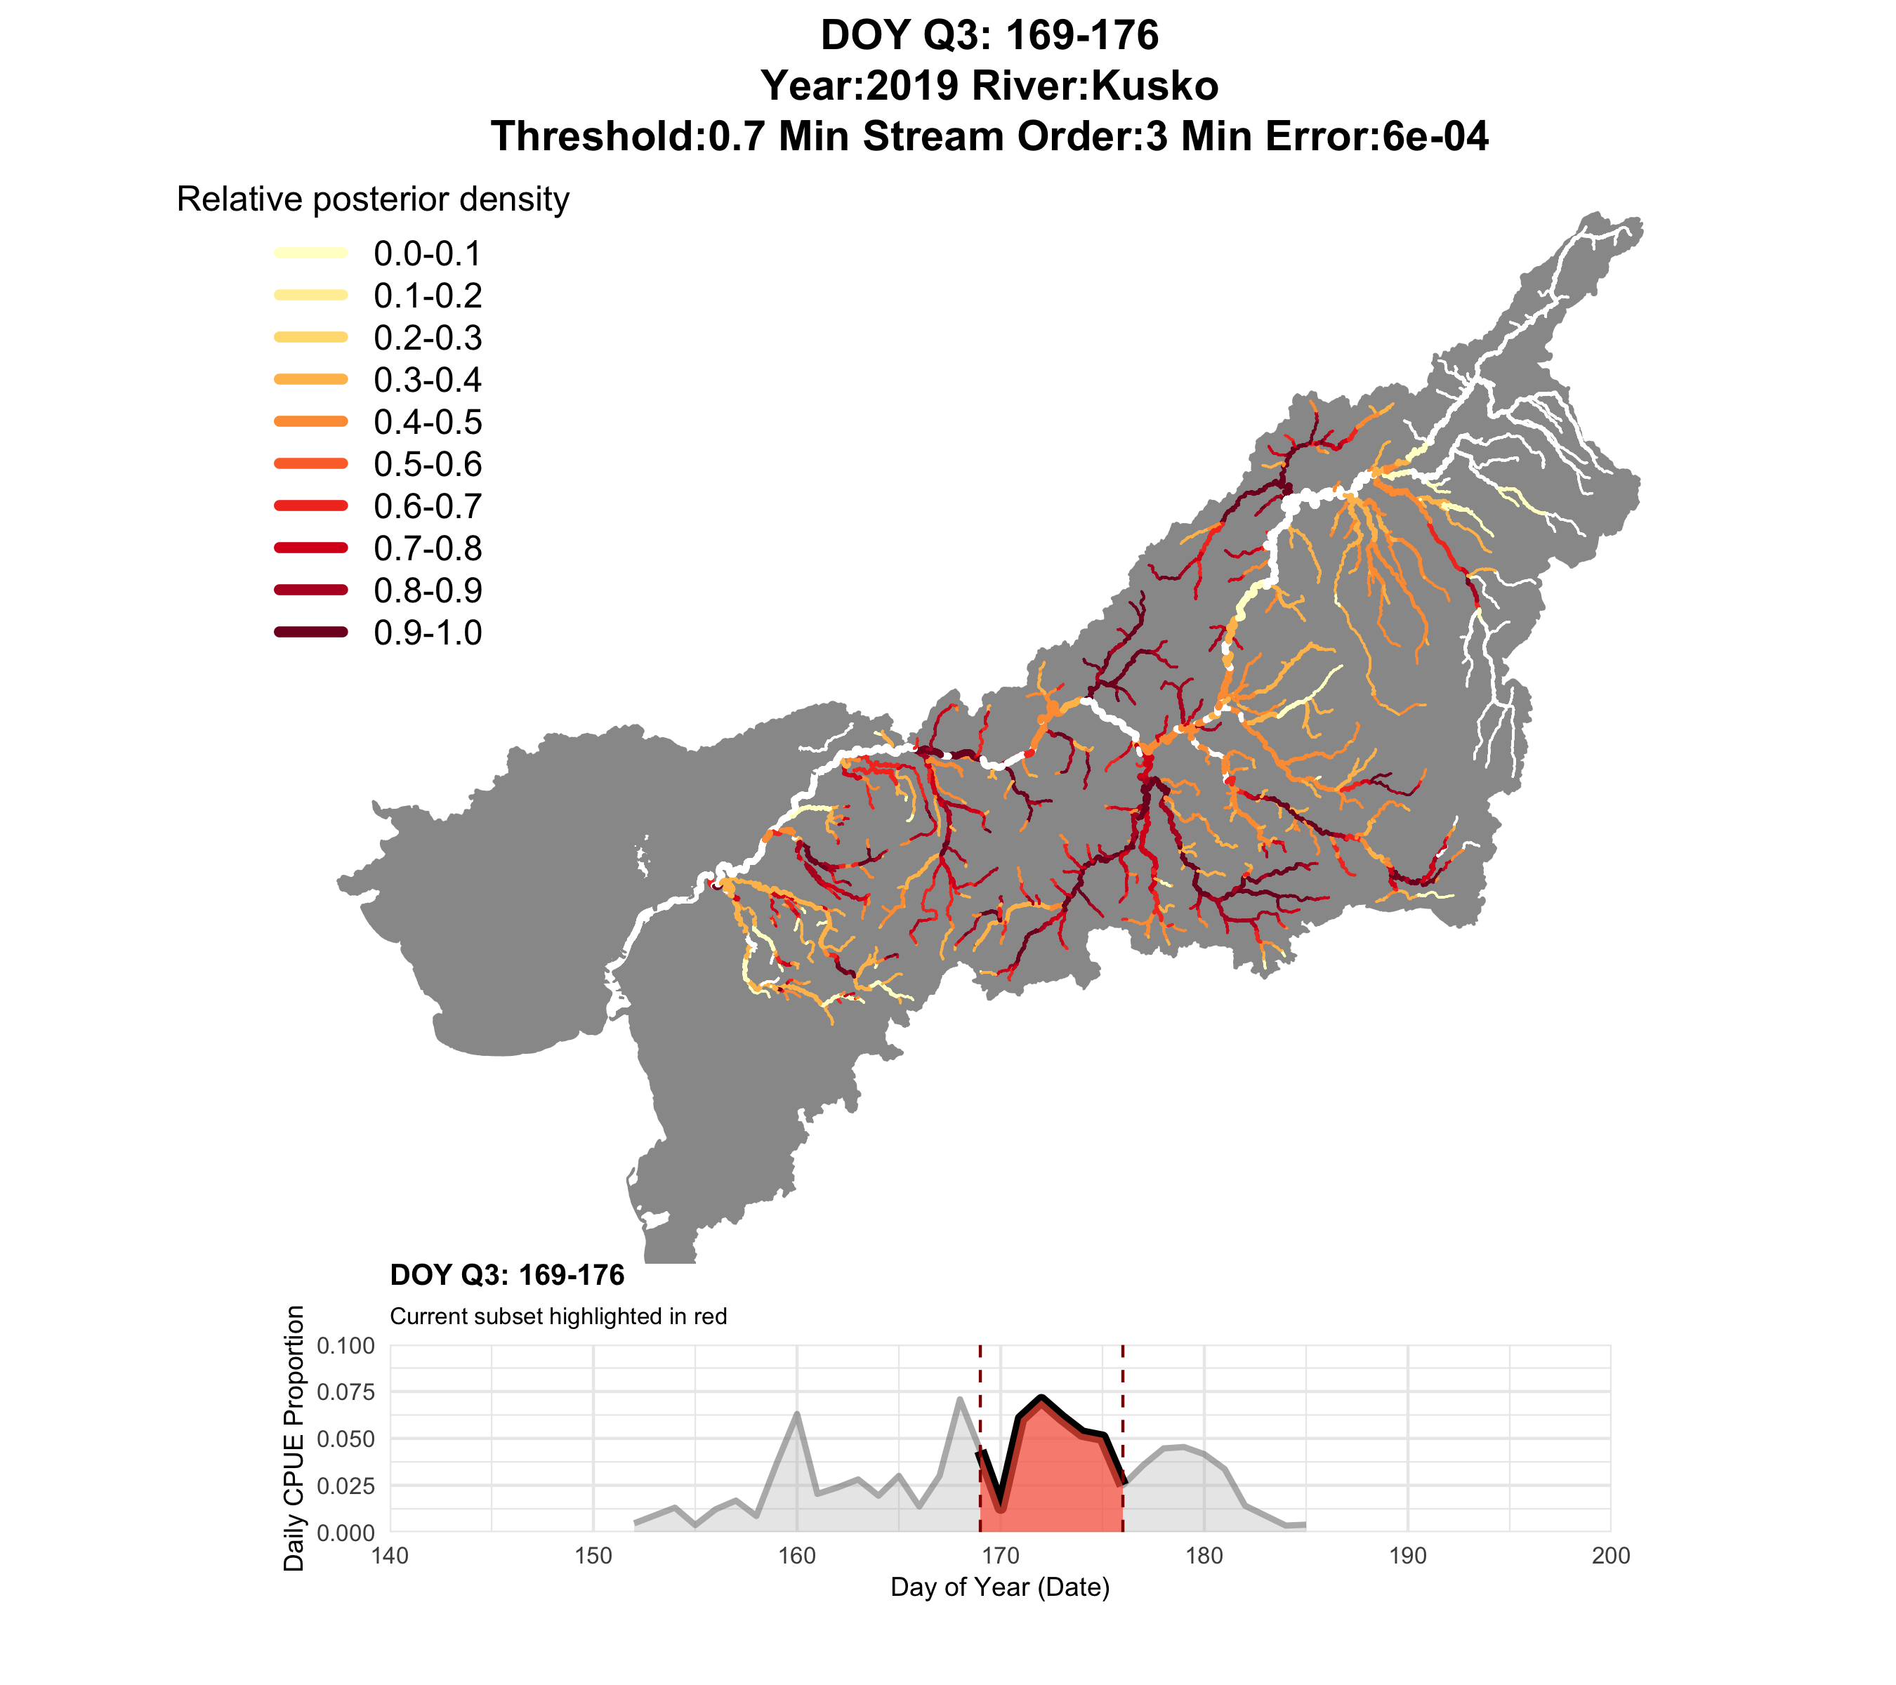

Slide 24
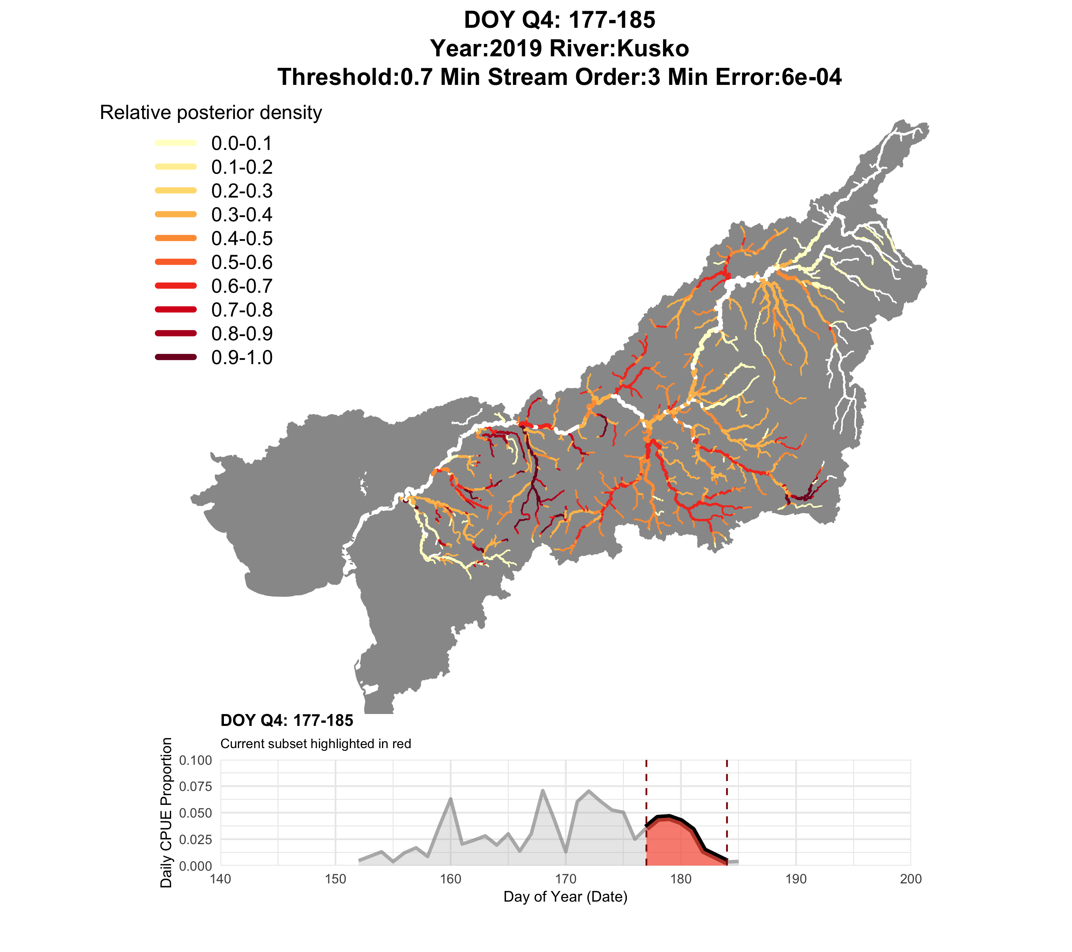
Too much going on here to make sense for management…

Slide 25
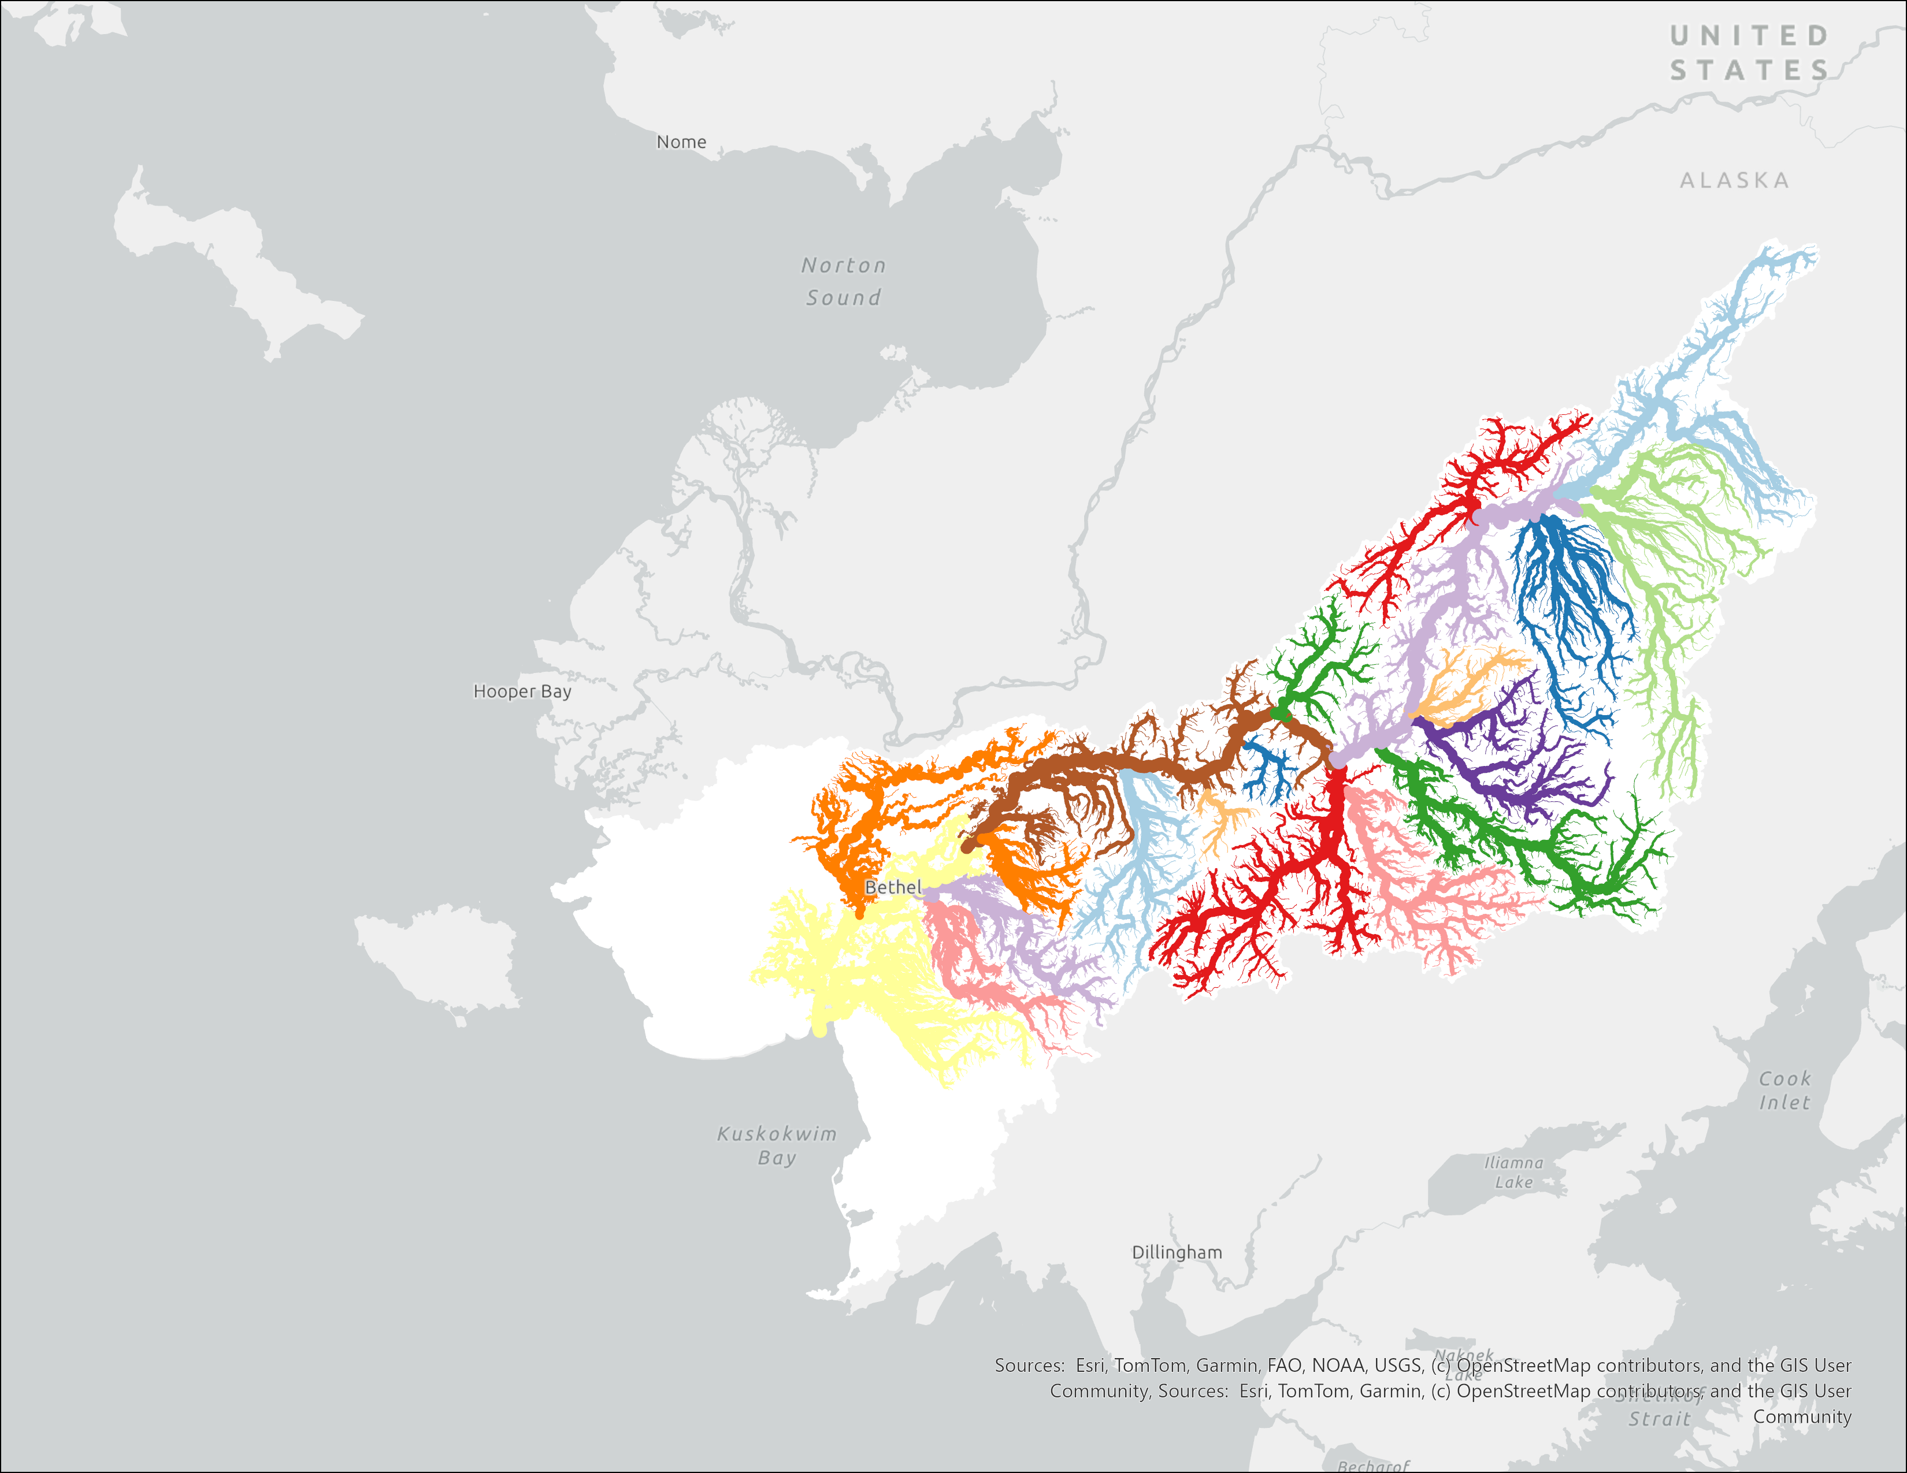
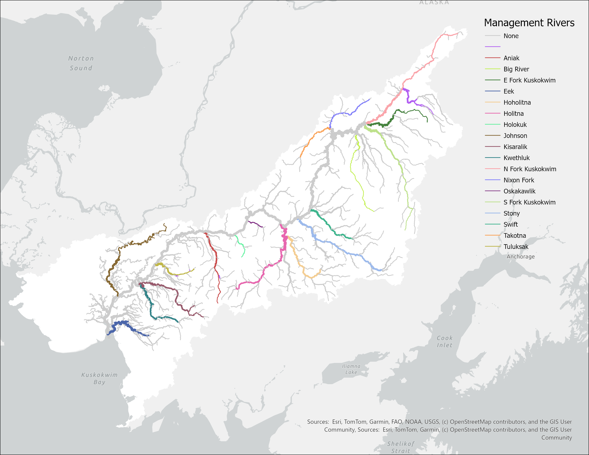

Slide 26
What were really interested in is not TOTAL returns but the prop of returns from each group at each quartile → full run into a number of timeseries for each group

Slide 27
DFA theory and why it works here
Potential covariates as hypotheses

Slide 28
Add a Q0, normalize the ts because we want 0 to be 0

Slide 29
First, start with the most complicated model
4 Quartiles, 4 states.
We expect obs variance is not equally distributed.
Include both covs.
Compare with AIC
Best support is for a model without run size or cpue
Test different covariance structures
Best support is for diagonal and unequal.

Slide 30
Results, patterns vs loadings non spatial

Slide 31
Results, patterns vs loadings spatial

Slide 32
Pull out the individual quartile patterns from these. T1

Slide 33
T2

Slide 34
T3

Slide 35
T4

Slide 36
Discussion, increasing Q1, decreasing Q4?

Slide 37
Changes to variance among stocks?

Slide 38
Risks of consolidating to a single LH, portfolio effect degradation

Slide 39
Conclusion

